Slide 1
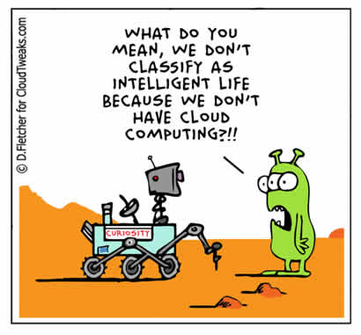
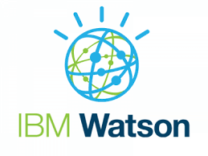

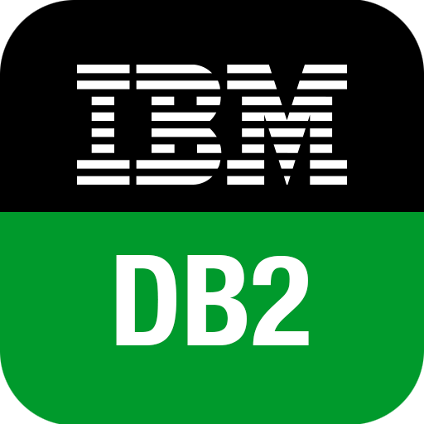
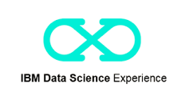
P02: IBM Cloud Services (PaaS, SaaS) - Lab
Notes:
In 1911, the Tabulating Machine Company, the International Time Recording Company and the Computing Scale Company merged to form the Computing-Tabulating-Recording Company (CTR). In the 1920s, CTR was responsible for such advances as the printing tabulator and the first electric key punch device. In 1924, CTR officially changed its name to the International Business Machines Corporation (IBM). In 1933, IBM expanded its product line to include electric writing machines. IBM remained profitable during the Depression, due in part to government contracts. In 1944, IBM helped to create the Automatic Sequence Controlled Calculator, later known as the Harvard Mark I. 1952 saw the development of the IBM 701, the first commercial scientific computer that IBM ever produced. In 1956, IBM introduced the IBM 305 Random Access Memory Accounting System (RAMAC), the first magnetic hard disk drive. In 1957, the company introduced the FORTRAN computer programming language. The System/360, developed in 1964, was a mainframe computer system that could be customized to the customer's needs. In 1981, the company introduced the IBM 5150, which came with Intel 8088 processor, a descendant of the first microprocessor ever created.

Slide 2
Outline
Objective
Bluemix
High-Level Architecture
Bluemix Cloud Foundry
Watch video – Demo: Getting Started with Node.js on Bluemix 2016
Examples
Web Application to Query in-Cloud Database
Web Application with Watson Personality Insights Service
In-cloud Data Analytics using Simple SQL and R Scripting
Summary

Slide 3
Objective
develop a simple SaaS application using IBM Bluemix PaaS and SaaS services
Example 1: A web server application for querying an in-cloud database
setting up an in-cloud database SaaS (Db2) and load data from the local computer
develop a simple SaaS web server application (using Node.js boilerplate PaaS) and linking with the in-cloud database SaaS
Example 2: A web server application for generating personality insights using cognitive analysis SaaS
perform cognitive analysis using Watson service from a Node.js web server application and retrieve results
Example 3: Using SaaS services for data analytics on cloud
use IBM Db2 Data Warehousing and DSX SaaS services for in-cloud data analytics with SQL and R scripting languages

Slide 4
Milestones
Successful login
Install CLI
Load web app
Load Watson web app
Run SQL query
Run R script and visualize data

Slide 5
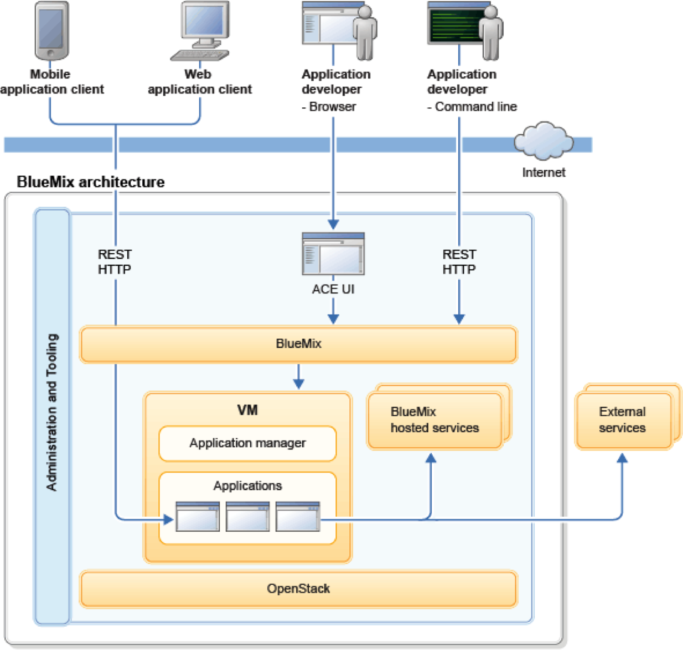
Bluemix High-level Architecture
Application developer interacts with systems through:
Command line interface
Browser interface
Notes:
In short, IBM Bluemix is an implementation of IBM open cloud architecture using Cloud Foundry, which is an open source cloud computing PaaS. IBM has also provided services and runtimes in the ecosystem based on the IBM software portfolio.
The following diagram shows the high-level architecture of IBM Bluemix. A variety of popular programming languages and frameworks like Android, iOS, HTML/JavaScript, Java, Ruby and PHP are offered in Bluemix environment.
http://yourstory.com/2014/06/bluemix-dummies/
Bluemix deploys virtual containers utilizing OpenStack to host deployed applications as indicated in the diagram
Users interact with the infrastructure by Bluemix user interface, a web-based user interface (UI).
A command line tool cf is used to deploy web applications.
Clients (mobile applications or web applications hosted externally or on Bluemix or human users using web browsers) can use REST/HTTP application programming interfaces (API) to interact with the hosted applications.

Slide 6
Bluemix Cloud Foundry
Users focus on application code, i.e., don’t have to worry about the OS and infrastructure layers
Cloud Foundry is an open source PaaS
Corporate users: SAS, Cisco, Rakuten, Baidu, SAP Verizon, ..
Leverages on the broad community
Push, extend and manage applications using
a command line tool – Bluemix CLI implements Cloud Foundry operations
eclipse plugin
DevOps …
Addresses PaaS lack of cross-compatibility among different cloud providers
Notes:
For interacting with Bluemix there are many ways, one is through the Bluemix Portal itself. But you can use commands from a command line. These commands are specifying to Cloud Foundry standards. I know I have now introduced one more jargon. So Cloud Foundry is an Open Source PaaS. And Bluemix complies to the Cloud Foundry specifications. Another advantage is that if you find services missing in Bluemix, you can get that from the Cloud Foundry (though w/o IBM support). You can also interact with Bluemix from Eclipse as well. So you have your app developed in Eclipse and can push that app into the Platform running in Bluemix. There is another way in which Bluemix one can interact with Bluemix. Which is the DevOps platform provided by IBM. Now you might be wondering what is DevOps. DevOps is a short form of Development and Operations. It is a software development method that helps collaboration and integration between software developers and IT operations professionals. Its goal is to help an organization rapidly produce software products and services. IBM also provides its DevOps Platform, https://hub.jazz.net. This runs on Softlayer Cloud. In a nutshell, what you get in IBM DevOps is a Web based Integrated Development Environment (to contrast Eclipse is a Local Development Environment sitting in one`s Desktop or Laptop machine), Version Control (eg : if version 1 code has ‘System.out.print (Hello World)’ and if version 2 of the code has ‘System.out.print (Hello My World)’, the developer would like to keep a track of what was the change in every version), create work items (eg: if there is a bug in the code, it would be possible to assign that to a developer to resolve it), keep a track of the work items, plan release dates of the code to production, keep a track of the release dates, and automatically deploy the code from IBM DevOps to the Bluemix.
http://yourstory.com/2014/06/bluemix-dummies/

Slide 7
Video
Demo: Getting Started with Node.js on Bluemix 2016

Slide 8
Developing a Web Application
Objective: set up a web server application using to retrieve data from an in-cloud database and display on a browser
Example: Web application to retrieve and display economic data of countries stored in a IBM Db2 database, running on a cloud-based web server using node.js boilerplate
Services can be added on top of the boilerplate runtime (eg. database service)
Data file: World bank economic statistics

Slide 9
Developing a Web Application
User Query
web application
Result
front end GUI
control script
database
web server
HTML Jade
……..
Node.js
Ruby
PHP
…………
Db2 Couldant Spark
…….
(layout design)
(program script)
Different technologies are offered by IBM Bluemix cloud

Slide 10


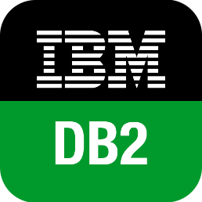
Developing a Web Application
What we are going to use for Example 1:
User Query
web application
Result
front end GUI
control script
database
web server
(layout design)
(program script)
PaaS: IBM Bluemix Node.JS Boilerplate
SaaS: IBM Db2

Slide 11
Developing a Web Application (relevant files)
What we are going to use for Example 1:
User Query
web application
Result
front end GUI
control script
database
web server
layout.jade
tablelist.jade
app.js index.js
stats.csv (data)
(layout design)
(program script)
PaaS: IBM Bluemix Node.JS Boilerplate
SaaS: IBM Db2
manifest.yml package.json (used by cloud foundry)

Slide 12
What is PaaS?
Platform
as a Service
Bluemix
Consumer
Data
Client manages
Data
Application
Application
Runtime
Runtime
Integration
Middleware
Database
Database
Provider
OS
OS
Bluemix
Virtualization
Virtualization
Server
Server
Storage
Storage
Network
Network
Cloud Foundry

Slide 13
Web Application Architecture
Use node.js and push the app to the Cloud using CloudFoundry CLI
Use web-browser to browse the created web application
Db2 database
web server
Notes:
In short, IBM Bluemix is an implementation of IBM open cloud architecture using Cloud Foundry, which is an open source cloud computing PaaS. IBM has also provided services and runtimes in the ecosystem based on the IBM software portfolio.
The following diagram shows the high-level architecture of IBM Bluemix. A variety of popular programming languages and frameworks like Android, iOS, HTML/JavaScript, Java, Ruby and PHP are offered in Bluemix environment.
http://yourstory.com/2014/06/bluemix-dummies/
Bluemix deploys virtual containers utilizing OpenStack to host deployed applications as indicated in the diagram
Users interact with the infrastructure by Bluemix user interface, a web-based user interface (UI).
A command line tool cf is used to deploy web applications.
Clients (mobile applications or web applications hosted externally or on Bluemix or human users using web browsers) can use REST/HTTP application programming interfaces (API) to interact with the hosted applications.

Slide 14
Main Steps: Web Application using Node.js
Sign up for IBM Bluemix
Select Db2 for Transactions from the catalog – only necessary if the application needs a database
Upload data to the newly created Db2 database create necessary tables
Modify/review data fields and get information necessary for remote access
Select Cloud Foundry Node.js app from the catalog – this is needed for every new application
Provide a hostname that serves as the web application URL – hostname.mybluemix.net
Install the Bluemix CLI (command line interface) client on your local machine - this is required if you have not done so previously
Add a connection to the database created in steps 2-4
To start a new web application, download the code (index.js, manifest.yml, app.js, package.json,.. ) onto your local directory
Modify manifest.yml with database host name
Deploy/upload application on Bluemix. Using the Bluemix CLI, connect the Bluemix client to the selected Bluemix region (server)
Using the Bluemix CLI, login to Bluemix and, upload your application to Bluemix!
To access the web application, enter your host URL (in step 5)

Slide 15
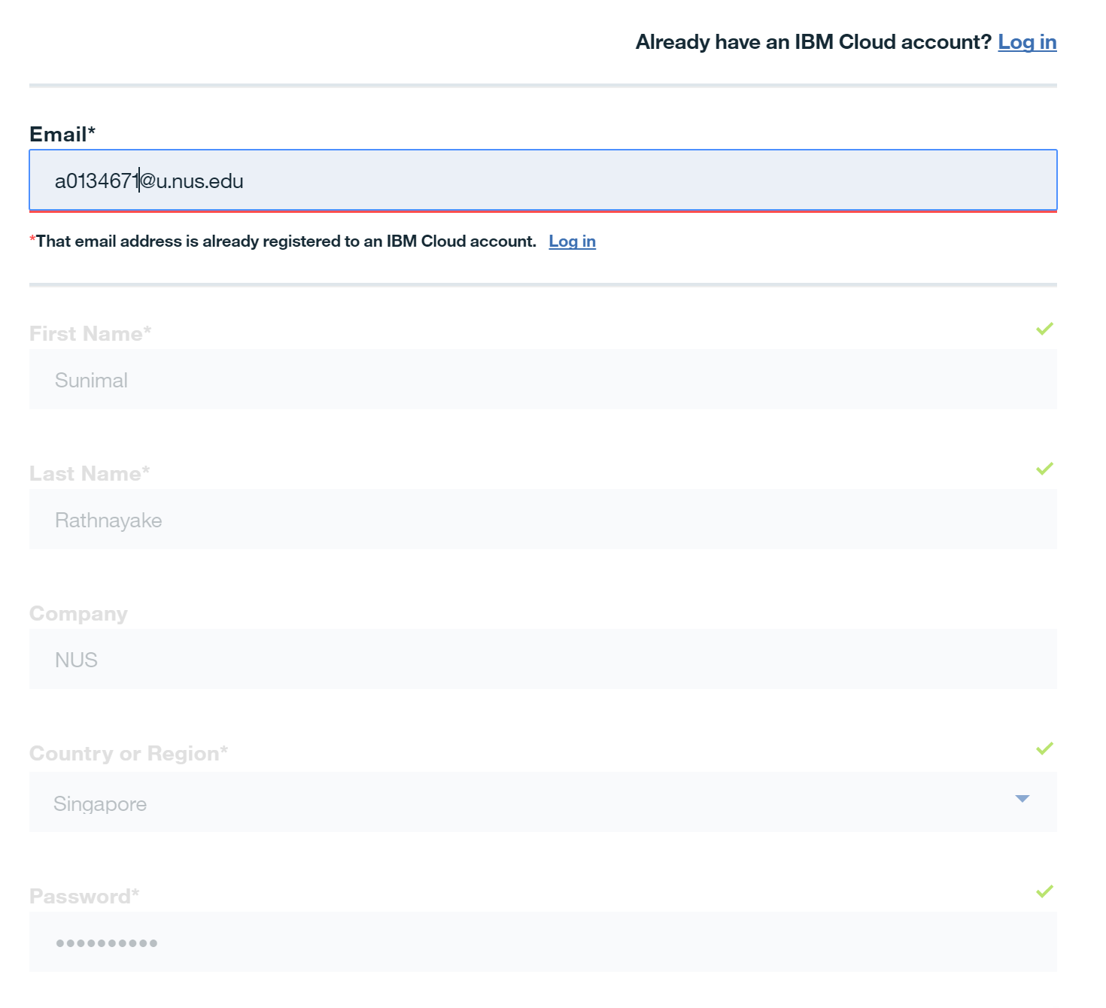
Step 1: Signing up
IBM Cloud sign up
https://console.bluemix.net/
Fill in the form with your details. Make sure to use the NUS school email.

Slide 16
Milestone 1: Successful Login
Did you successfully log in to IBM Bluemix?
Let’s wait until everyone is done!
In the meantime:
Explore the array of services offered in Bluemix

Slide 17
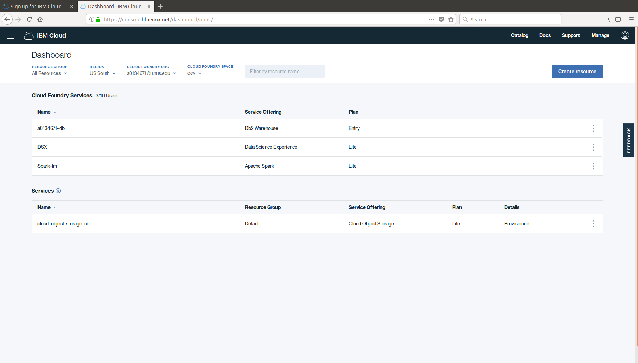
IBM Cloud Platform – Bluemix
Notes:
Run apps in any language, Built on open standards, Provides integration services to your systems of record
Designed for mobile, Provides DevOps services for integrated dev experience
Open Standards, Cloud based platform to build, manage and run applications of all types be it web based applications or mobile based or big data and so on….
Also includes application monitoring features…all of it is mainly “open –source “ with some caveats of course.

Slide 18
How to instantiate Bluemix services?
Two ways to instantiate a Bluemix service
Using the web browser interface (Bluemix web console)
eg. select Db2 on the web interface and do the setup through the web browser.
created service can be later connected with other application such as web applications
we demonstrate this in Example 1 (Db2 service)
Using the command line interface (IBM Cloud CLI)
eg. issue a command through the CLI to instantiate a service (managed by cloud foundry software)
we demonstrate this in Example 2 (Watson personality insights service)

Slide 19
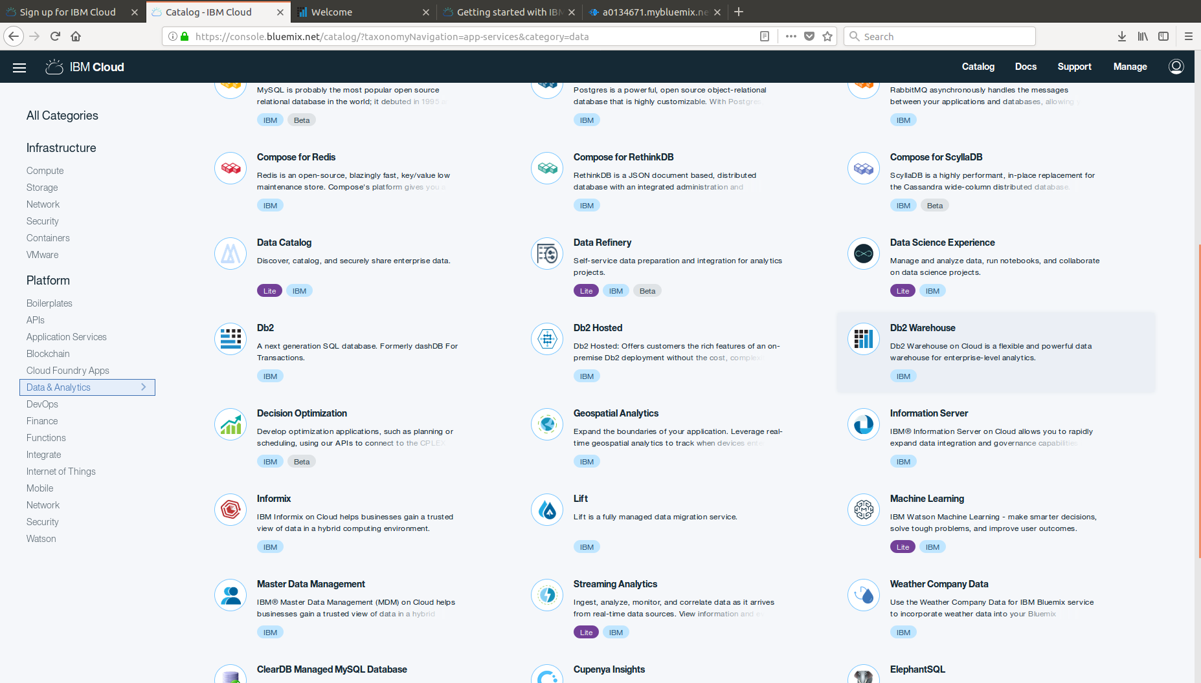
Step 2: Select Db2 from Catalog

Slide 20
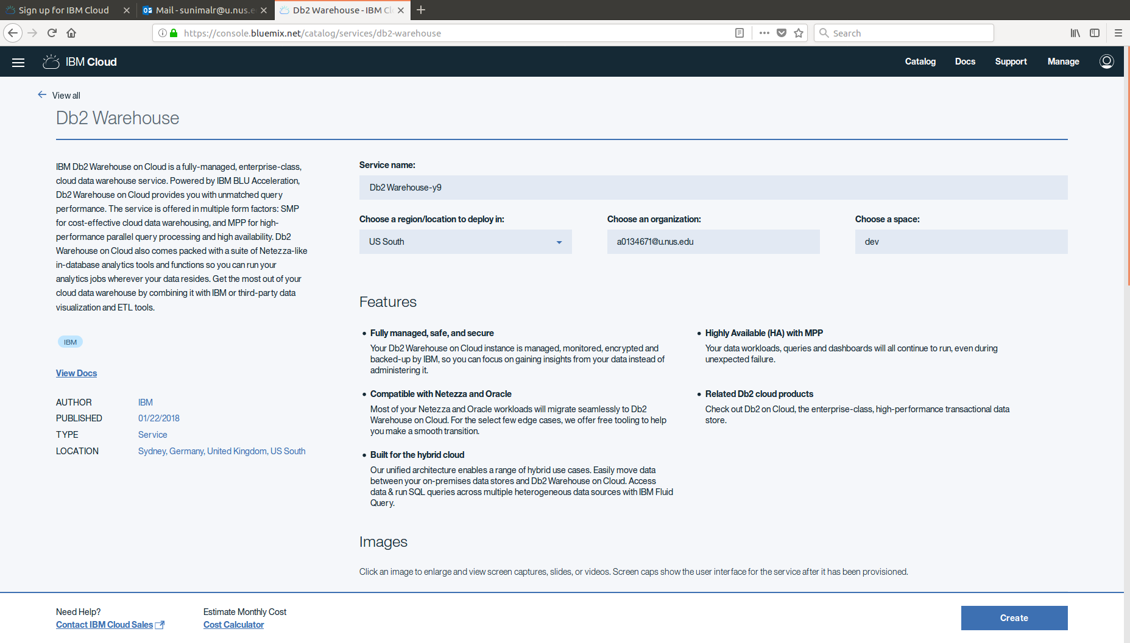
Step 2: Db2 Setup

Slide 21
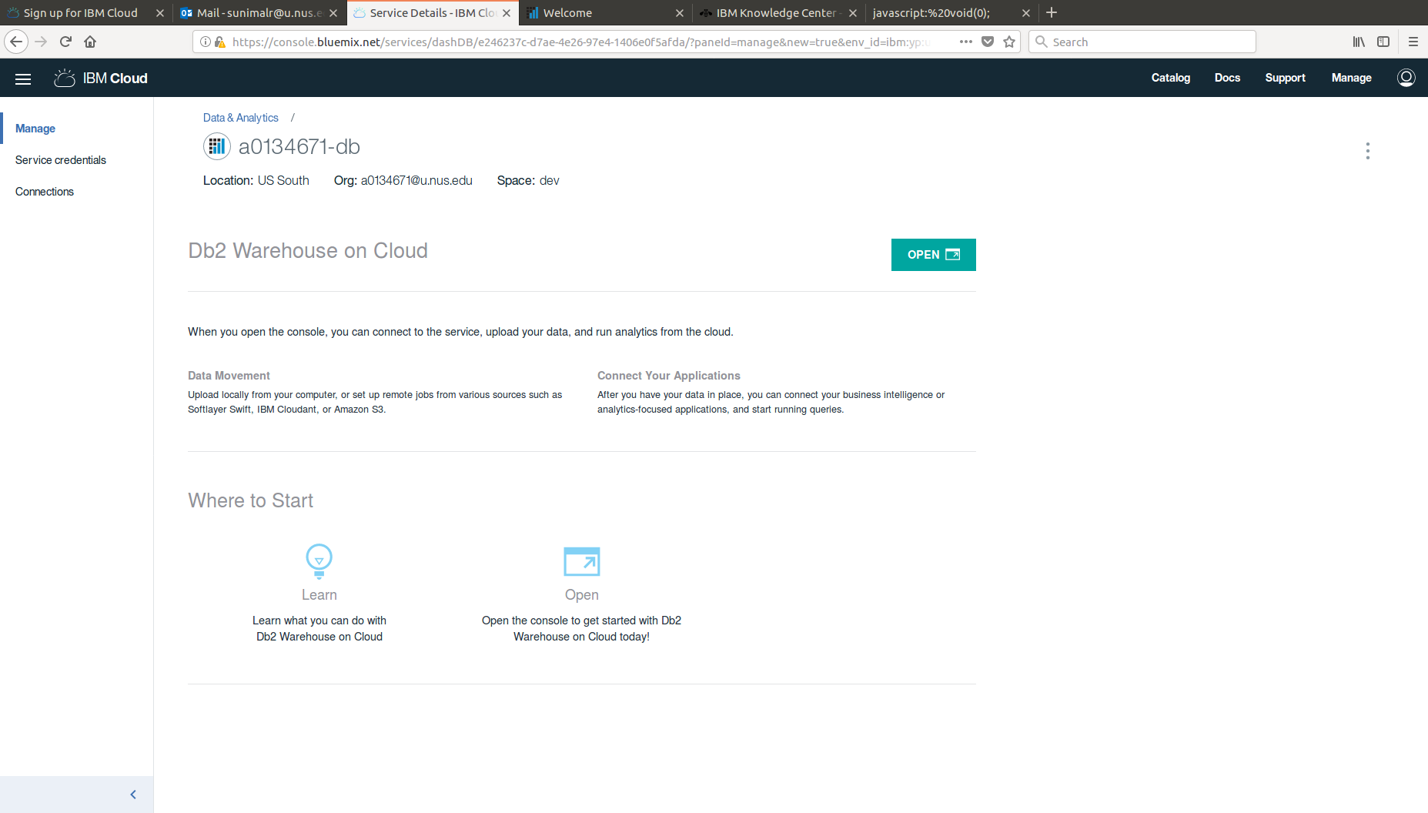
Step 2: Open Db2 Console

Slide 22
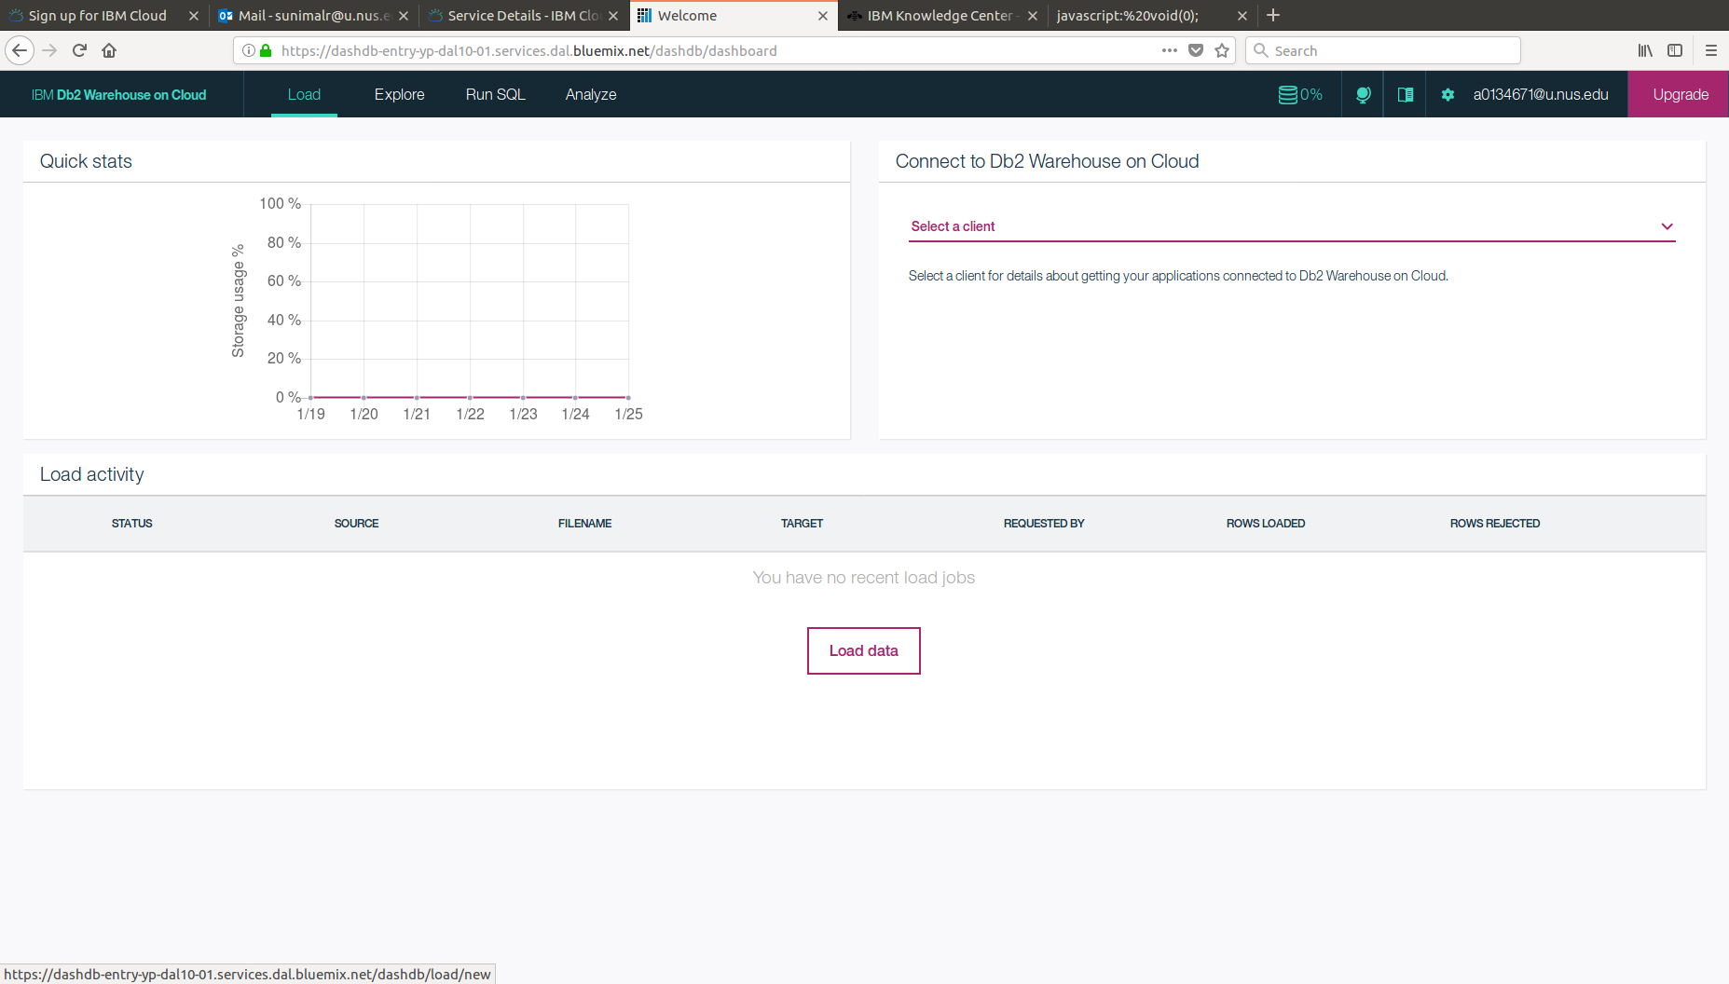
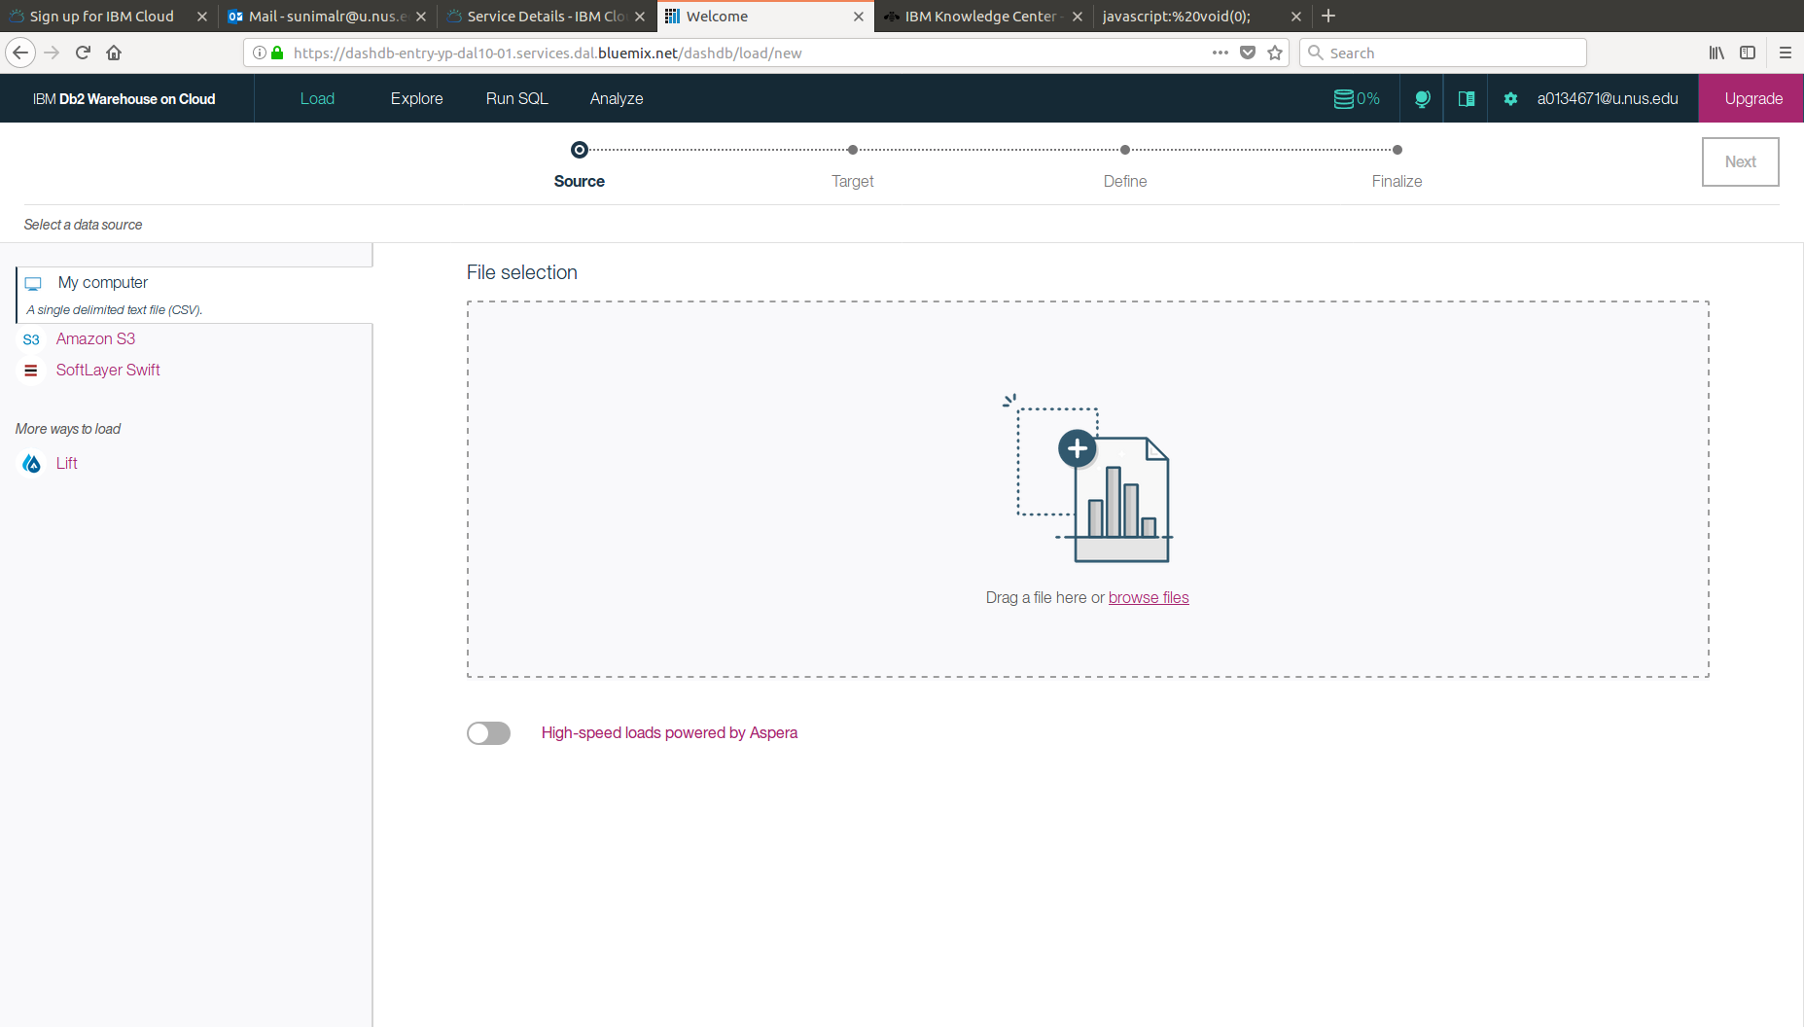
Step 3: Upload data
First download stats.csv data file from the course webpage, then upload to Db2

Slide 23
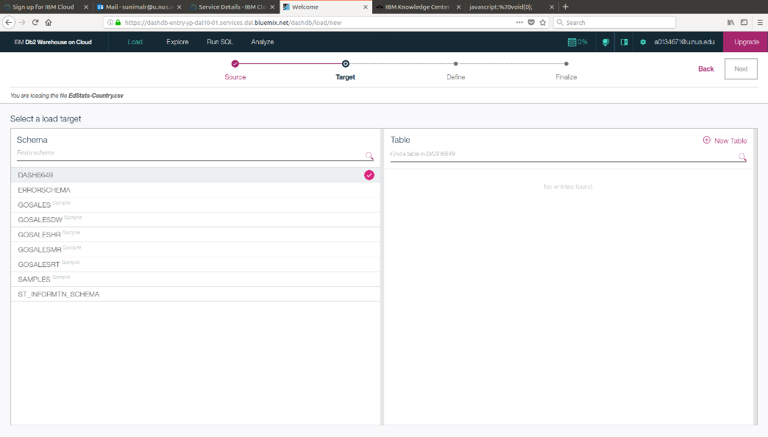
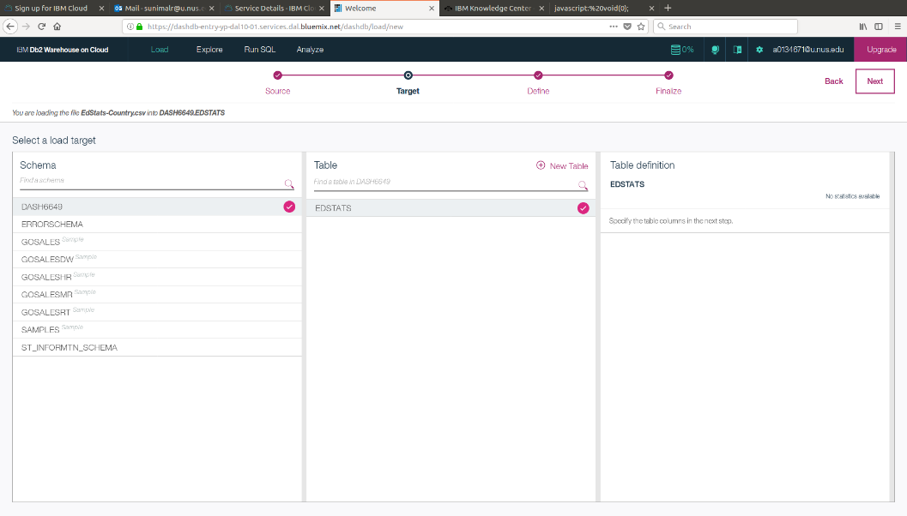
Step 4: Select Scheme, Table Name and, Review Table
Create a new table “STATS”
To connect database with another app, we need to note the “scheme” and the “tables” name.

Slide 24
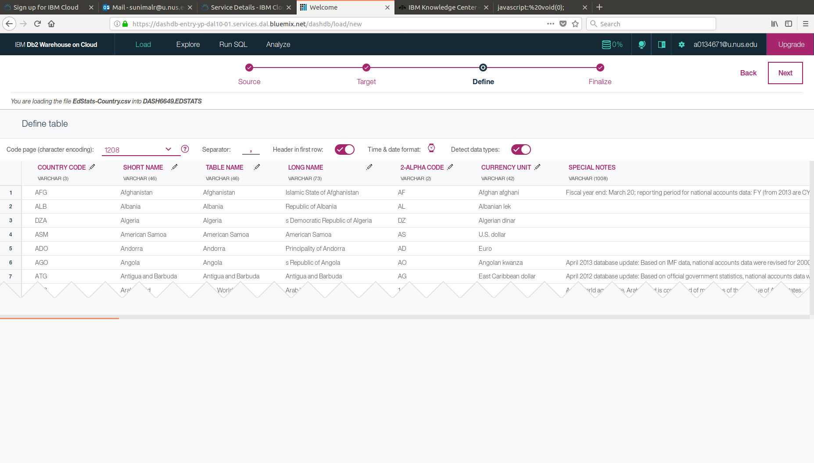
Step 4: Select Scheme and Table Name
Preview
You can change the column names if necessary
Review settings
Click Begin Load
Note the table name. We need this in next steps

Slide 25
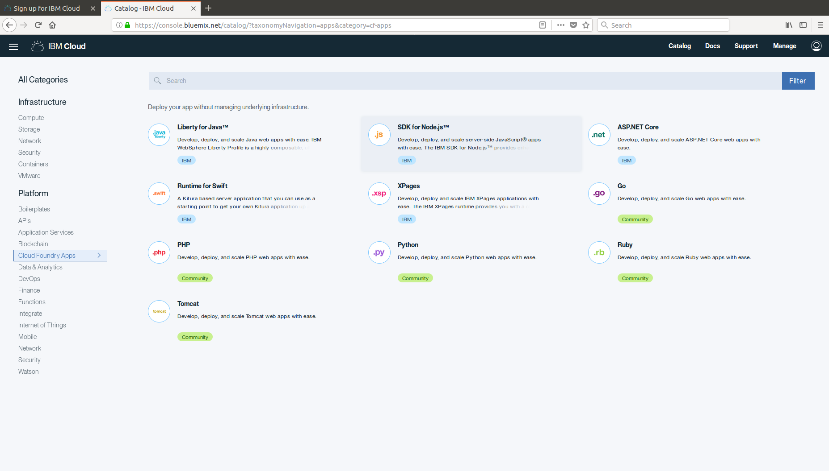
Step 5: Select Cloud Foundry Node.js
Go back to catalog and select SDK for Node.js under CloudFoundry apps

Slide 26
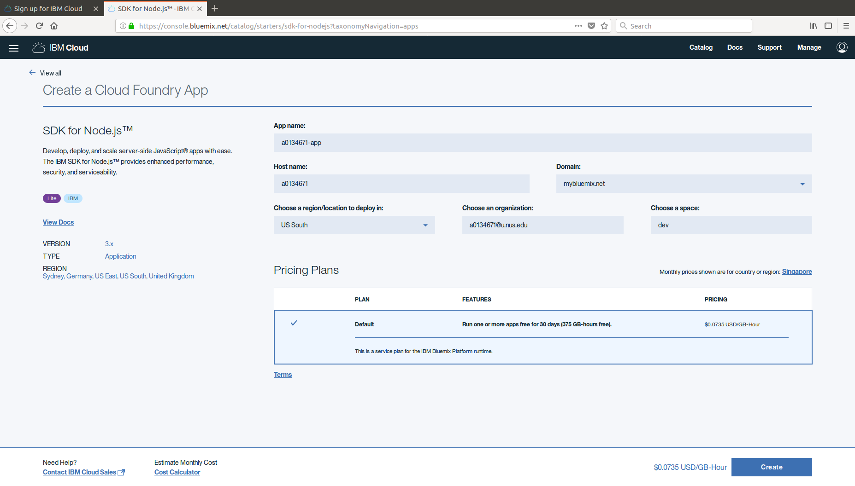
Step 6: Provide required app details
Use a unique app name and hostname. I use my NUSNET id.

Slide 27
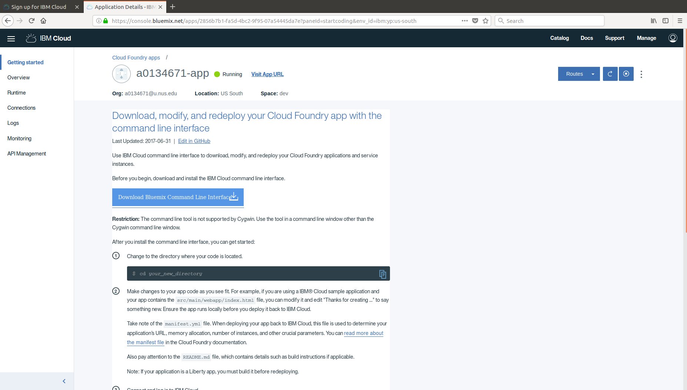
Step 7 : Install Bluemix CLI

Slide 28
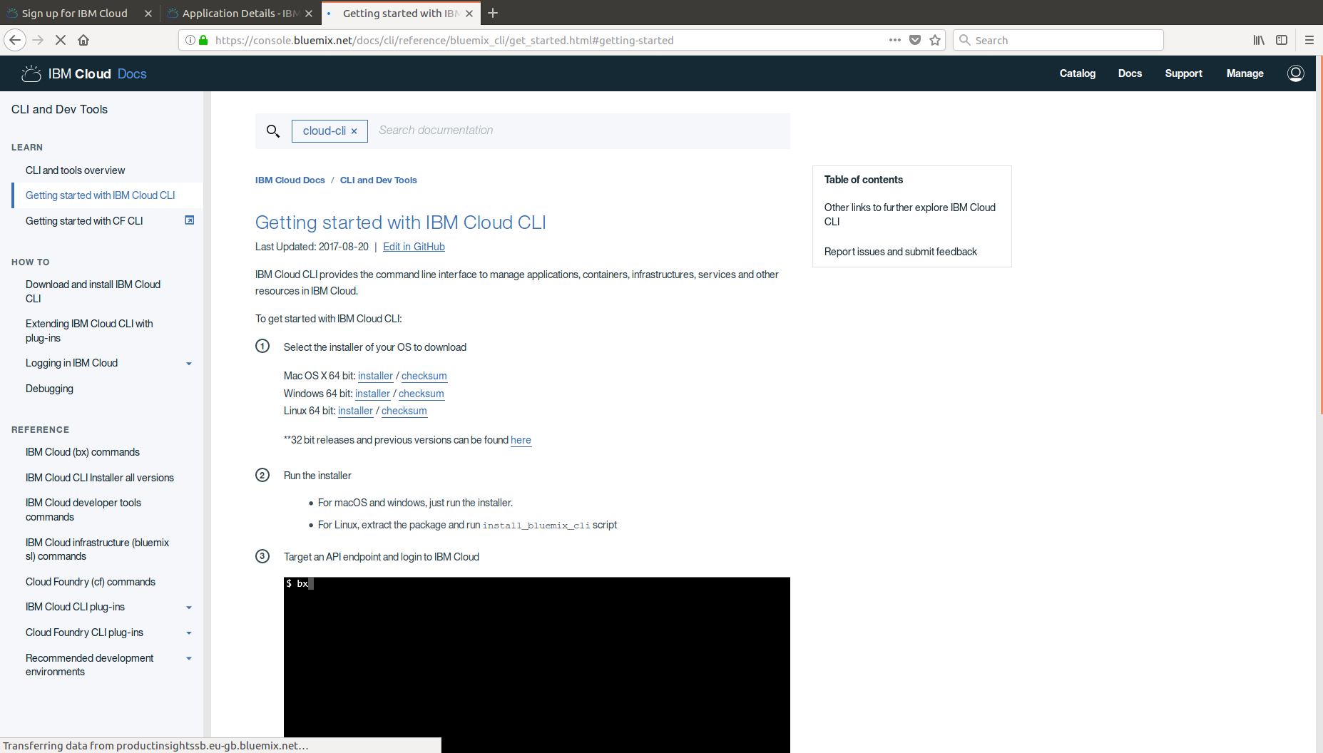
Step 7 : Install Bluemix CLI

Slide 29
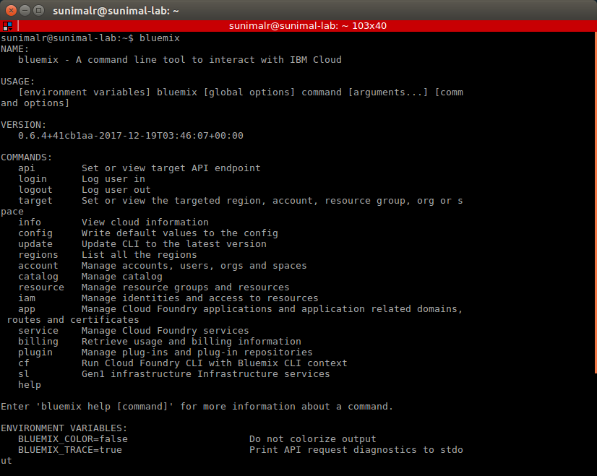
Step 7 : Install Bluemix CLI
Open command line and enter ‘bluemix’ and see if installation is a success. (as below)

Slide 30
Milestone 2: Install CLI
Did you successfully install Bluemix CLI?
Bluemix CLI implements Cloud Foundry services.
Let’s wait until everyone is done!
In the meantime:
Read more about cloud foundry at: http://searchcloudcomputing.techtarget.com/definition/Cloud-Foundry

Slide 31
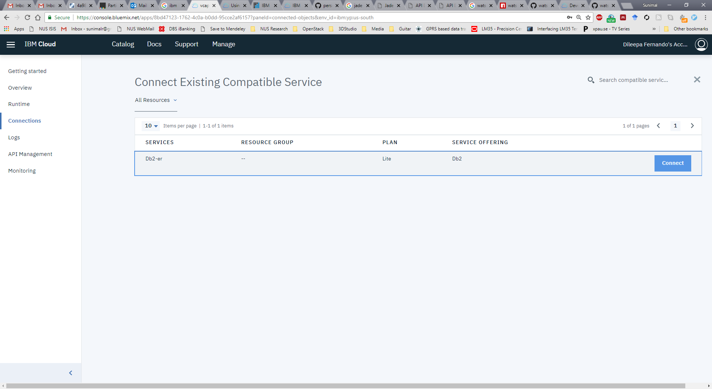
Step 8: Connect the web app to Db2 database

Slide 32
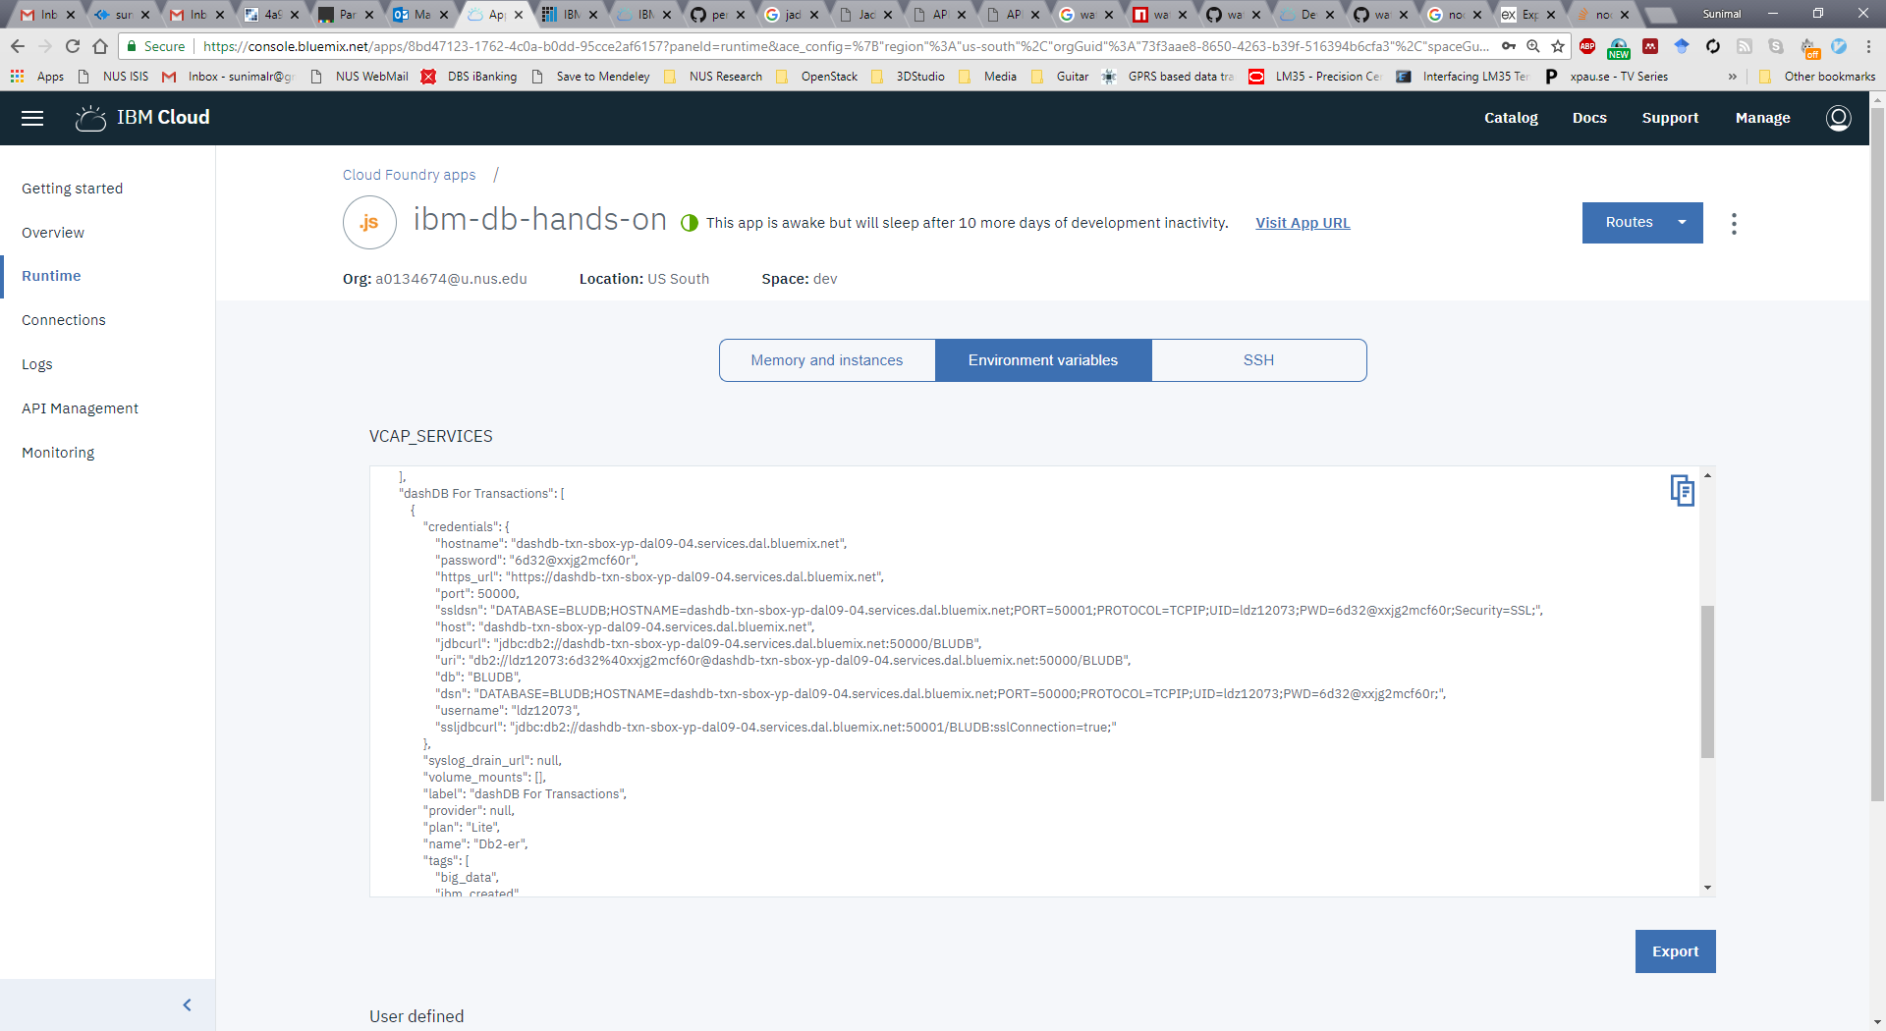
Step 8: Note the environment variables
Under runtime tab, you can see VCAP_SERVICES environment variables. This information is needed for external connections.

Slide 33
Step 9: Download Node.js content files
Download the db-app.zip file from the course web page to your local computer and extract
File structure
app.js – web application core
manifest.yml – deployment parameters for Cloud Foundry
package.json – app dependencies
routes/index.js – functions to connect to Database
Take note of manifest.yml and package.json which sets deployment parameters and resolve dependencies when deploying applications via Cloud Foundry and app.js file which sets up server variables and initiates the web server

Slide 34
List of data and code with location (Example 1)
Data files
stats.csv (downloaded at above Step3)
Source files(db-app.zip file downloadable from course webpage)
db-app
views
layout.jade
tablelist.jade
routes
index.js
app.js
manifest.yml
package.json
layout design
control logic
dependencies and app properties

Slide 35
app.js
var express = require('express');
var routes = require('./routes');
var http = require('http');
var path = require('path');
var ibmdb = require('ibm_db');
require('cf-deployment-tracker-client').track();
var app = express();
// all environments
app.set('port', process.env.PORT || 3000);
app.set('views', path.join(__dirname, 'views'));
app.set('view engine', 'jade');
app.use(express.favicon());
app.use(express.logger('dev'));
app.use(express.json());
app.use(express.urlencoded());
app.use(express.methodOverride());
app.use(express.cookieParser('your secret here'));
app.use(express.session());
app.use(app.router);
app.use(express.static(path.join(__dirname, 'public')));
var db2;
var hasConnect = false;
// development only
if ('development' == app.get('env')) {
app.use(express.errorHandler());
}
if (process.env.VCAP_SERVICES) {
var env = JSON.parse(process.env.VCAP_SERVICES);
if (env['dashDB']) {
hasConnect = true;
db2 = env['dashDB'][0].credentials;
}
}
if ( hasConnect == false ) {
db2 = {
db: "BLUDB",
hostname: "xxxx",
port: 50000,
username: "xxx",
password: "xxx"
};
}
var connString = "DRIVER={DB2};DATABASE=" + db2.db + ";UID=" + db2.username + ";PWD=" + db2.password + ";HOSTNAME=" + db2.hostname + ";port=" + db2.port;
app.get('/', routes.listSysTables(ibmdb,connString));
http.createServer(app).listen(app.get('port'), function(){
console.log('Express server listening on port ' + app.get('port'));
});

Slide 36
package.json
{
"engines": {
"node": "^4"
},
"name": “db2dbnodesample",
"version": "0.0.1",
"description": "A sample node app for connecting to db2 service on Bluemix",
"dependencies": {
"cf-deployment-tracker-client": "^0.0.8",
"express": "^3.5.3",
"ibm_db": "^2.0.0",
"jade": "^1.11.0"
},
"scripts": {
"start": "node app.js"
},
}
}

Slide 37
manifest.yml
---
declared-services:
dashDB-nodesample:
label: "dashDB For Transactions"
plan: Lite
applications:
# replace the host variable below with your own unique one, as this one can be already taken
- name: ibm-db-hands-on
memory: 64M
instances: 1
path: .
host: sunimal
framework: node
command: node app.js
buildpack: sdk-for-nodejs
services:
- Db2-er

Slide 38
index.js
exports.listSysTables = function(ibmdb,connString) {
return function(req, res) {
ibmdb.open(connString, function(err, conn) {
if (err ) {
res.send("error occurred " + err.message);
}
else {
conn.query("SELECT * FROM LDZ12073.STATS FETCH FIRST 10 ROWS ONLY", function(err, tables, moreResultSets) {
if ( !err ) {
res.render('tablelist', {
"tablelist" : tables,
"tableName" : "10 rows from the STATS table",
"message": "Congratulations. Your connection to Db2 is successful."
});
} else {
res.send("error occurred " + err.message);
}
/*
Close the connection to the database
param 1: The callback function to execute on completion of close function.
*/
conn.close(function(){
console.log("Connection Closed");
});
});
}
} );
}
}
Note: index.js is located in the ‘routes’ folder

Slide 39
layout.jade
doctype html
html
head
title= title
link(rel='stylesheet', href='/stylesheets/style.css')
body
block content
tablelist.jade
extends layout
block content
h1=message
h2=tableName
form#list-form
div#main
table#list
thead
tr
for hdr in Object.keys(tablelist[0])
th #{hdr}
tbody
if tablelist && tablelist.length > 0
each row in tablelist
tr
each col in row
td #{col}
Note: located in the ‘views’ folder

Slide 40
Step 10: Modify index.js
Use the schema.table name from step 4
exports.listSysTables = function(ibmdb,connString) {
return function(req, res) {
ibmdb.open(connString, function(err, conn) {
if (err ) {
res.send("error occurred " + err.message);
}
else {
conn.query("SELECT * FROM LDZ12073.STATS FETCH FIRST 10 ROWS ONLY", function(err, tables, moreResultSets) {
if ( !err ) {
res.render('tablelist', {
"tablelist" : tables,
"tableName" : "10 rows from the STATS table",
"message": "Congratulations. Your connection to Db2 is successful."
});
} else {
res.send("error occurred " + err.message);
}
/*
Close the connection to the database
param 1: The callback function to execute on completion of close function.
*/
conn.close(function(){
console.log("Connection Closed");
});
});
}
} );
}
}
Note: index.js is located in the ‘routes’ folder

Slide 41
Step 10: Modify manifest File
---
declared-services:
dashDB-nodesample:
label: "dashDB For Transactions“ plan: Lite
applications:
# replace the host variable below with your own unique one, as this one can be already taken
- name: your app name here
memory: 64M
instances: 1
path: .
host: your host name here
framework: node
command: node app.js
buildpack: sdk-for-nodejs
services:
- name for the database (eg: db-<your nusnet id>) – we did this in step 2
this is the maximum allowed RAM for the app. When you create the app in web console (in step 2 and 3), you may be asked to select memory size. Use that number here.

Slide 42
Steps 11, 12: Cloud Foundry and Bluemix
Open command line and change directory into the folder with code downloaded in the previous step
Use the Bluemix CLI to connect to the Bluemix API (Depending on the region you are logged on to. ‘ng’ is for US South)
bluemix api https://api.ng.bluemix.net
Login to Bluemix
>bluemix login -u <bluemix_id> -o <organization> -s <space>
use the IBM ID and password
upload your application to Bluemix
bluemix app push <appname>
Notes:
Cf push starts the HelloWorld.js server
Using the information in the manifest.yml file, Bluemix knows how to create a runtime for the application
• Using information in package.json, it will realize that this application needs express.js in order to run, and it will run the NodePackage Manager to get that dependency installed (you’ll see lots of information scroll up your screen as express.js and its dependencies get installed)
• Finally, it starts server.js

Slide 43
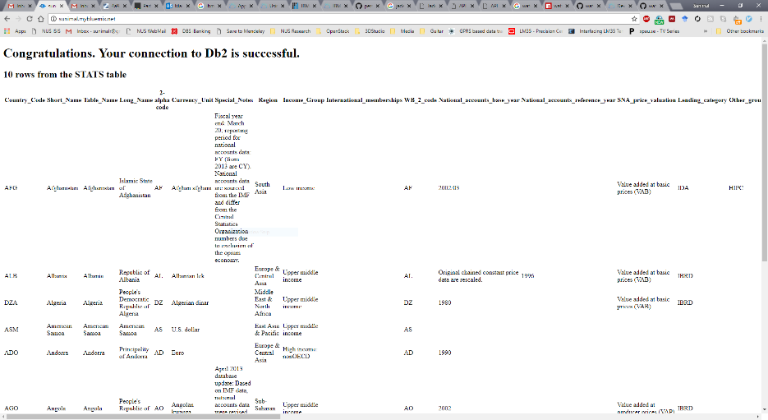
Step 13: View App
Go to your favorite browser and enter the URL:
http://your_host_name.mybluemix.net
Alternatively, you can try mine at
http://sunimal.mybluemix.net
You should see the contents of the database on the web browser

Slide 44
Milestone 3: Load Web App
Did you successfully load the web app?
Let’s wait until everyone is done!
In the meantime:
Read more about core node.js files at: https://docs.cloudfoundry.org/buildpacks/node/node-tips.html

Slide 45
Web Application using Watson Analytics
Watson is a cognitive analysis service powered by different AI techniques
Watson could be used for different cognitive tasks such as
summarize a text to filter important points
analyze a person’s personality based on a their resume
build interactive chat-bots to communicate with clients and answer their questions
……….
Watson comes with a comprehensive API that helps integrate it with other IBM tools and services such as database, machine learning, web applications, among others

Slide 46
Watson Analytics
Objective: use SaaS service (Watson) to get personality insights from a piece of text
Example: a web server application to upload a part of a text and call IBM Watson services to get personality insights based on the uploaded text
Data: part of a text from US former president Barak Obama’s speech

Slide 47

Developing a Web Application
What we are going to use for Example 2
User Query
web application
Result
front end GUI
control script
Watson
web server
(layout design)
(program script)
SaaS: IBM Watson
PaaS: IBM Bluemix Node.JS Boilerplate

Slide 48
Developing a Web Application
What we are going to use for Example 2
User Query
web application
Result
front end GUI
control script
Watson
web server
index.html
styles.css
app.js
Obama-speech.txt(data)
(layout design)
(program script)
SaaS: IBM Watson
PaaS: IBM Bluemix Node.JS Boilerplate
manifest.yml package.json (used by cloud foundry)

Slide 49
Watson Analytics: Main Steps in Setting up Web Server Application
Sign up for IBM Bluemix and go to the Catalog
Select Cloud Foundry Node.js app from the catalog – this is needed for every new application
Provide a hostname that serves as the web application URL – hostname.mybluemix.net
Install the Bluemix CLI (command line interface) client on your local machine - this is required only if you have not done so previously. We did this in Example 1.
To start a new web application, download the code (index.js, manifest.yml, app.js, package.json,.. ) onto your local directory from course web site
Modify manifest.yml (and other source code files as necessary)
Using Bluemix CLI, login to Bluemix
Create Watson personality insights service using CLI
Using the Bluemix CLI, upload your application to Bluemix!
To access the web application, enter your host URL (in step 3)
In Example 2 we demonstrate how to create a service with the CLI without using the web browser interface (step 8)

Slide 50
Step 2: Select Cloud Foundry Node.js
Go back to catalog and select SDK for Node.js under CloudFoundry apps

Slide 51
Step 3: Provide required app details
Use a unique app name and hostname. (this should be different from the hostname you gave in Example 1)

Slide 52
Step 5: Download Node.js content files
Download the watson-app.zip file from the course web page to your local computer and extract it
File structure
app.js – web application core
manifest.yml – deployment parameters for Cloud Foundry
package.json – app dependencies
public/index.html – web layout
Take note of manifest.yml and package.json which sets deployment parameters and resolve dependencies when deploying applications via Cloud Foundry and app.js file which sets up server variables and initiates the web server

Slide 53
List of data and code with location (Example 2)
Data files (watson-data.zip downloadable from course webpage)
watson-data
obama-speech.txt
Source files (watson-app.zip downloadable from course webpage)
watson-app
public
stylesheets
style.css
index.html
routes
app.js
manifest.yml
package.json
layout design
control logic
dependencies and app properties

Slide 54
app.js
/*eslint-env node*/
//------------------------------------------------------------------------------
// node.js starter application for Bluemix
//------------------------------------------------------------------------------
// This application uses express as its web server
// for more info, see: http://expressjs.com
var express = require('express');
// cfenv provides access to your Cloud Foundry environment
// for more info, see: https://www.npmjs.com/package/cfenv
var cfenv = require('cfenv');
// create a new express server
var app = express();
// serve the files out of ./public as our main files
app.use(express.static(__dirname + '/public'));
// get the app environment from Cloud Foundry
var appEnv = cfenv.getAppEnv();
// start server on the specified port and binding host
app.listen(appEnv.port, '0.0.0.0', function() {
// print a message when the server starts listening
console.log("server starting on " + appEnv.url);
});
var watson = require('watson-developer-cloud'),
multer = require('multer');
var creds = appEnv.getServiceCreds('personality-insights-tutorial');
creds.version = 'v2';
var personalityInsights = watson.personality_insights(creds);
var uploading = multer({
storage: multer.memoryStorage()
});
app.set('json spaces', 4);
app.post('/upload', uploading.single('file'), function (request, response) {
console.log("file");
var txtFile = request.file.buffer.toString();
console.log(request.file.buffer);
personalityInsights.profile({
text: txtFile },
function (error, result) {
if (error) {
response.send(error);
}
else {
response.json(result);
}
}
);
});
//---Deployment Tracker---------------------------------------------------------
require('cf-deployment-tracker-client').track();
Open the file in a text editor to clearly see/modify the content

Slide 55
package.json
{
"name": "NodejsStarterApp",
"version": "0.0.1",
"description": "A sample nodejs app for Bluemix",
"scripts": {
"start": "node app.js"
},
"dependencies": {
"body-parser": "^1.14.2",
"cfenv": "1.0.x",
"express": "4.12.x",
"multer": "^1.1.0",
"watson-developer-cloud": "1.x",
"cf-deployment-tracker-client": "*"
},
"engines": {
"node": "0.12.x"
},
"repository": {
"type": "git",
"url": "https://github.com/IBM-Bluemix/personality-insights-nodejs-tutorial.git"
}
}

Slide 56
public/index.html
<!DOCTYPE html>
<html>
<head>
<title>NodeJS Watson Application</title>
<meta charset="utf-8">
<meta http-equiv="X-UA-Compatible" content="IE=edge">
<meta name="viewport" content="width=device-width, initial-scale=1">
<link rel="stylesheet" href="stylesheets/style.css">
</head>
<body>
<form action="/upload" method="POST" enctype="multipart/form-data">
Select a txt file to upload:
<input type="file" name="file">
<input type="submit" value="Upload File">
</form>
</body>
</html>

Slide 57
Step 6: Modify manifest.yml
---
declared-services:
personality-insights-tutorial:
label: personality_insights
plan: lite
applications:
- path: .
memory: 64M
instances: 1
domain: mybluemix.net
name: sunimal-watson
host: sunimal-watson
disk_quota: 1024M
services:
- personality-insights-tutorial
this is the maximum allowed RAM for the app. When you create the app in web console (in step 2 and 3), you may b e asked to select memory size. Use that number here.
use the hostname and app name you selected

Slide 58
Step 7-9: Bluemix CLI Steps
Open command line and change directory into the folder with code downloaded in the previous step
Use the Bluemix CLI to connect to the Bluemix API (Depending on the region you are logged on to. ‘ng’ is for US South)
bluemix api https://api.ng.bluemix.net
Login to Bluemix
bluemix login -u <bluemix_id> -o <organization> -s <space>
use the IBM ID and password
Create the Personality Insights service in Bluemix
bluemix create-service personality_insights tiered personality-insights-tutorial
upload your application to Bluemix
bluemix app push <appname>

Slide 59
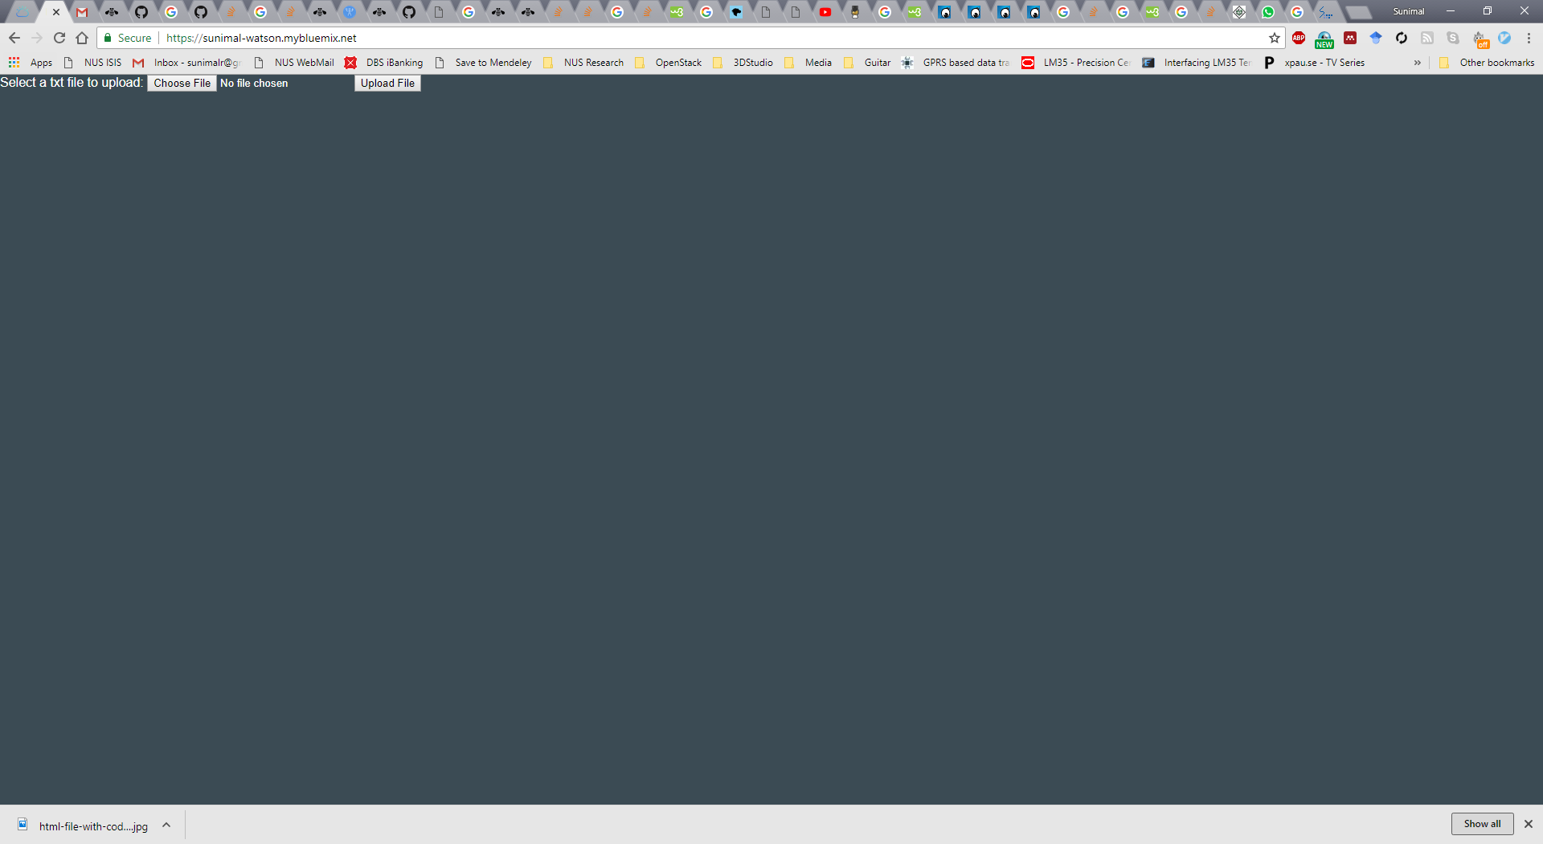
Step 10: View Result
Choose a file and upload it using the command buttons.

Slide 60
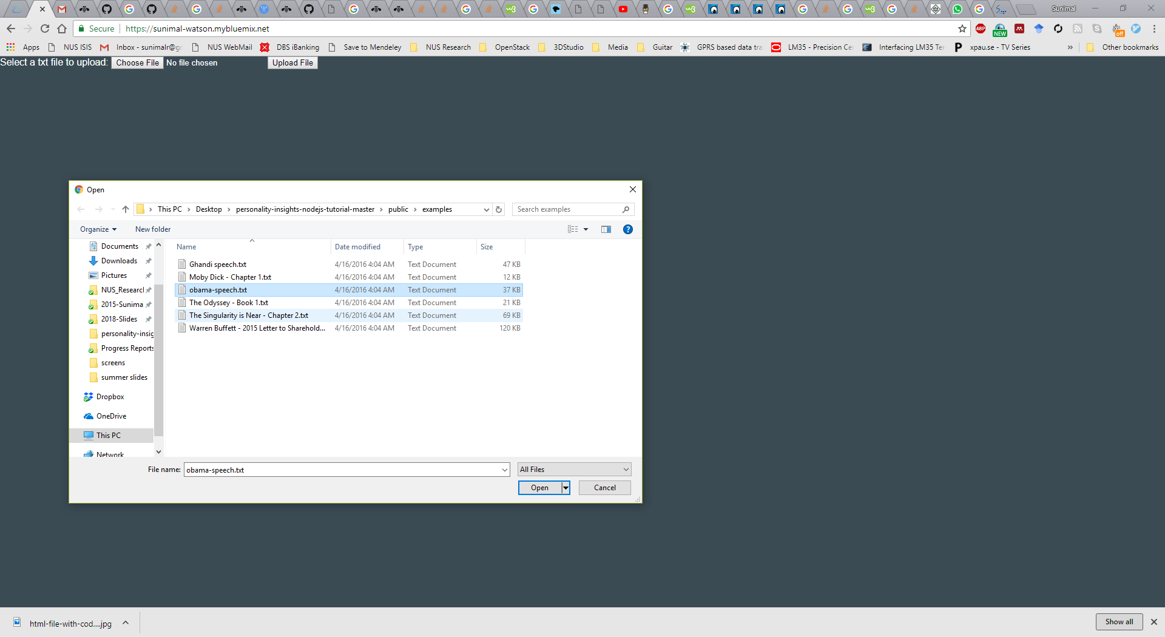
Step 10: View Result
Uploading obama-speech.txt
Download this file from course web page

Slide 61
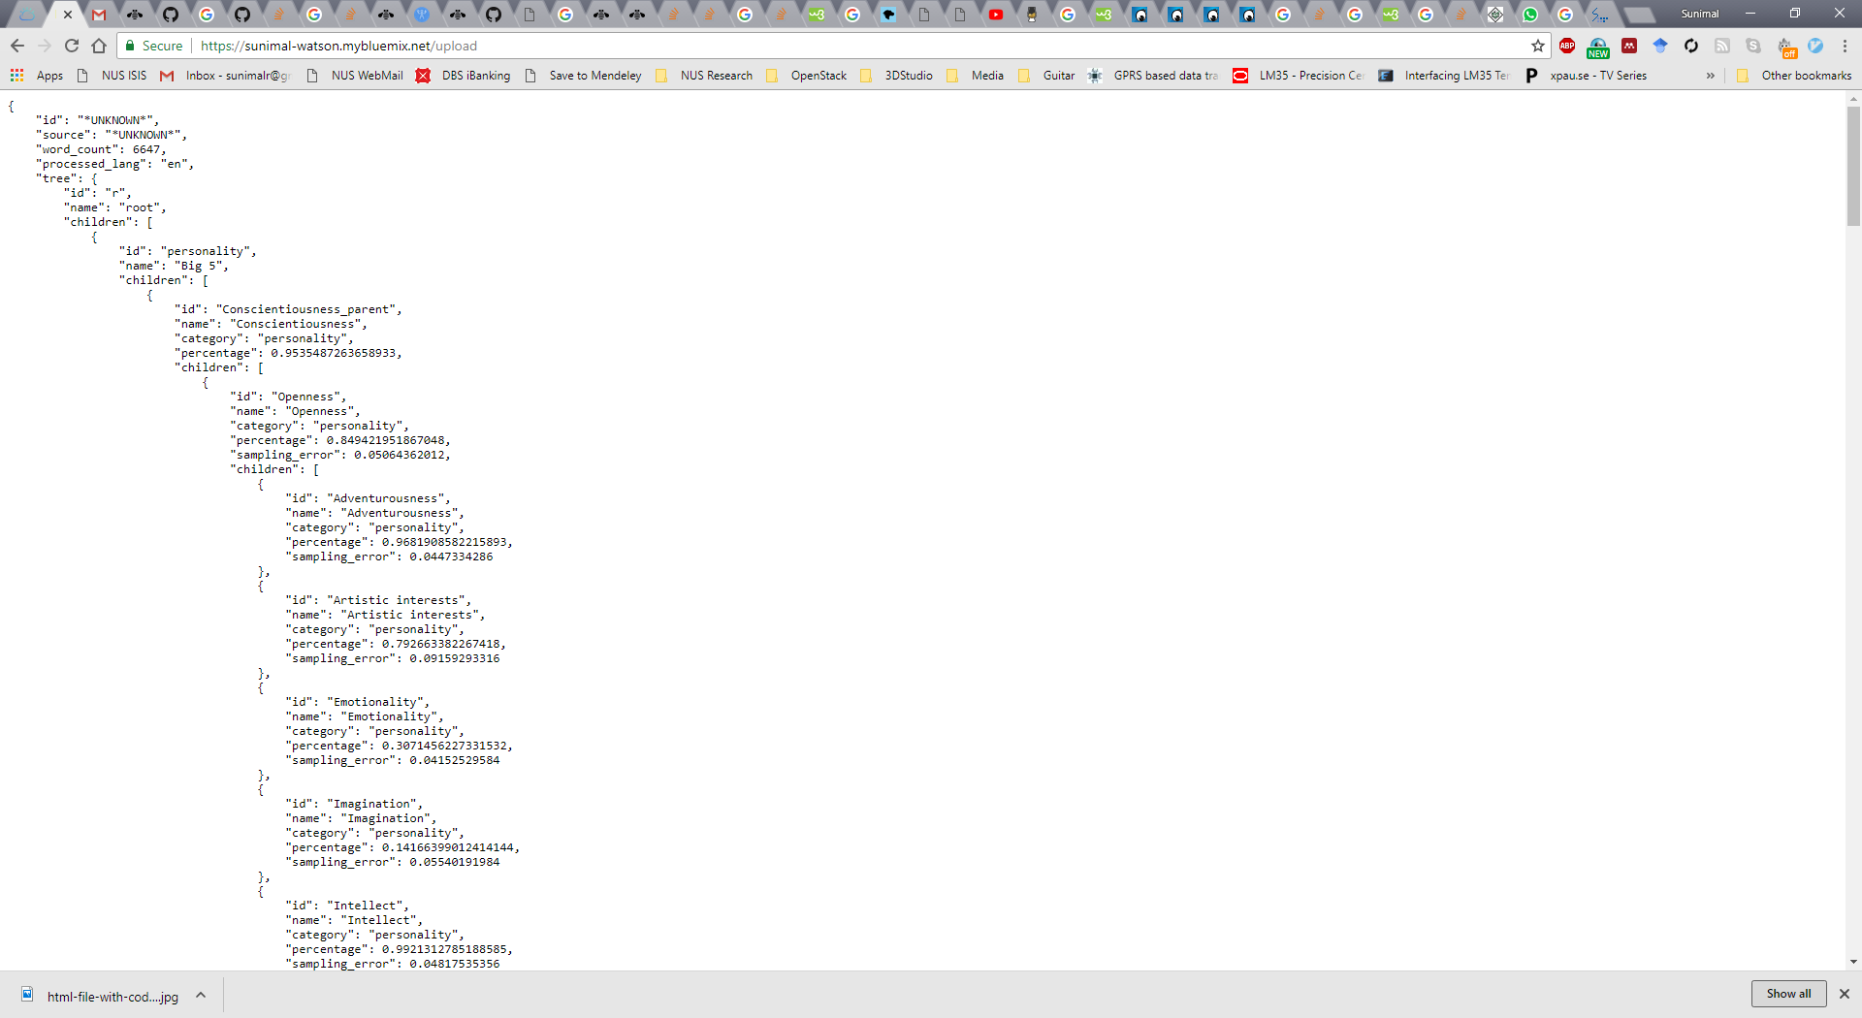
Step 10: View Result
Result appears in JSON format.
You can see different percentages for different personality attributes.
You may format the output to display and visualize nicely using your web development skills by modifying source code.

Slide 62
Milestone 4: Load Watson Web App
Did you successfully load the web app?
Let’s wait until everyone is done!
In the meantime:
Learn more about available services under IBM Watson on the Bluemix console

Slide 63
What is SaaS?
Software
as a Service
Bluemix
Client
manages
Consumer
Data
Data
Application
Application
Runtime
Runtime
Integration
Middleware
Database
Database
Provider
OS
OS
Bluemix
Virtualization
Virtualization
Server
Server
Storage
Storage
Network
Network
Cloud Foundry

Slide 64
Example 3 Querying with SQL Scripting
SQL is a querying language used for accessing and querying databases
IBM Cloud offers in cloud SQL language support with Db2 (e.g. IBM Db2 Warehousing)
Objective: Storing and querying data with a database query language
Example: Load economic data of countries to a an IBM Db2 database, and, run simple SQL queries on-cloud on the stored dataset
Data: Economic data of countries from United Nations (stats.csv)

Slide 65
Example 3-Part 1: Querying with SQL Scripting
SQL is a querying language used for accessing and querying databases
IBM Cloud offers in cloud SQL language support with Db2 (e.g. IBM Db2 Warehousing)
Objective: Storing and querying data with a database query language
Example: Load economic data of countries to a an IBM Db2 database, and, run simple SQL queries on-cloud on the stored dataset
Data: Economic data of countries from United Nations (stats.csv)

Slide 66
SaaS: Analytics using DB2 Service
Extend SaaS to write SQL query and R code in web-browser
Notes:
In short, IBM Bluemix is an implementation of IBM open cloud architecture using Cloud Foundry, which is an open source cloud computing PaaS. IBM has also provided services and runtimes in the ecosystem based on the IBM software portfolio.
The following diagram shows the high-level architecture of IBM Bluemix. A variety of popular programming languages and frameworks like Android, iOS, HTML/JavaScript, Java, Ruby and PHP are offered in Bluemix environment.
http://yourstory.com/2014/06/bluemix-dummies/
Bluemix deploys virtual containers utilizing OpenStack to host deployed applications as indicated in the diagram
Users interact with the infrastructure by Bluemix user interface, a web-based user interface (UI).
A command line tool cf is used to deploy web applications.
Clients (mobile applications or web applications hosted externally or on Bluemix or human users using web browsers) can use REST/HTTP application programming interfaces (API) to interact with the hosted applications.

Slide 67
Main Steps: Analytics using DB2 Warehouse
Login to Bluemix and go to Catalog
Select DB2 Warehouse under Data & Analytics and setup
Open DB2 console
Upload data (CSV or Excel) from local computer
Review upload data on the cloud
Run SQL
Start an ‘IBM Data Science Experience - DSX’ account
Create and setup new DSX project
Connect DSX to Db2 database
Create a ‘R’ notebook
Insert R data frame
Write R script to analyze data
Output the plot
Example 2-Part1: SQL Scripting
Example 2-Part2: R Scripting
NOTE: Some IBM accounts will show DSX as part of Watson Studio.

Slide 68
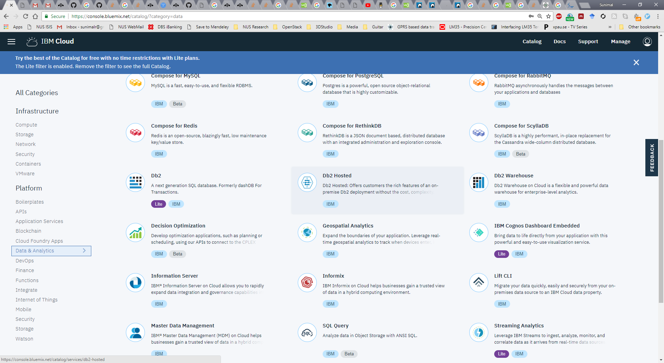
Step 1: Select Db2 Warehouse

Slide 69
Step 2: Db2 Warehouse Setup

Slide 70
Step 3: Open Db2 Warehouse Console

Slide 71
Step 4: Upload data
First download stats.csv data file from the course webpage, then upload to Db2

Slide 72
Step 5: Select Scheme, Table Name and, Review Table
Create a new table “EDSTATS”

Slide 73
Step 5: Select Scheme and Table Name
Preview
You can change the column names if necessary
Review settings
Click Begin Load
Note the table name. We need this in next steps

Slide 74
Step 6: Run SQL Query
Few things to note
SQL syntaxes slightly change across implementations (mysql, mssql, db2)
While loading file (step 5), the field names are shown in ALL CAPS, but this is in accurate
To see correct column names, go to ‘Explore’ tab

Slide 75
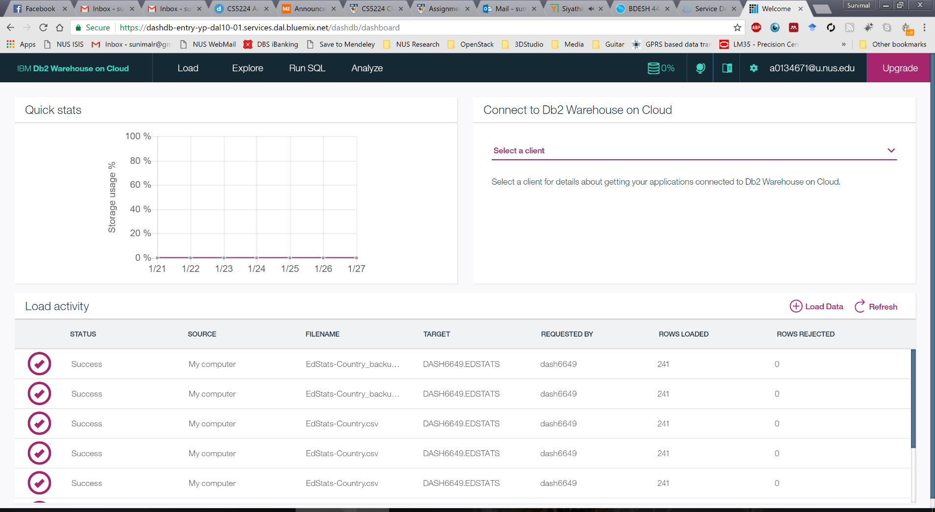
Step 6: Run SQL Query
Click “Run SQL” to enter the SQL console

Slide 76
Step 6: Run SQL Query
Find out countries that fall under the low income group and has their country code starting with S
SELECT "Country_Code","Long_Name","Currency_Unit","Income_Group","System_of_trade"
FROM <INSERT Database table name here eg. DASH6649.EDSTATS>
WHERE "Income_Group" LIKE 'Low%' AND "Country_Code" LIKE 'S%';
Database name should be set as required by referring to the database tables.

Slide 77
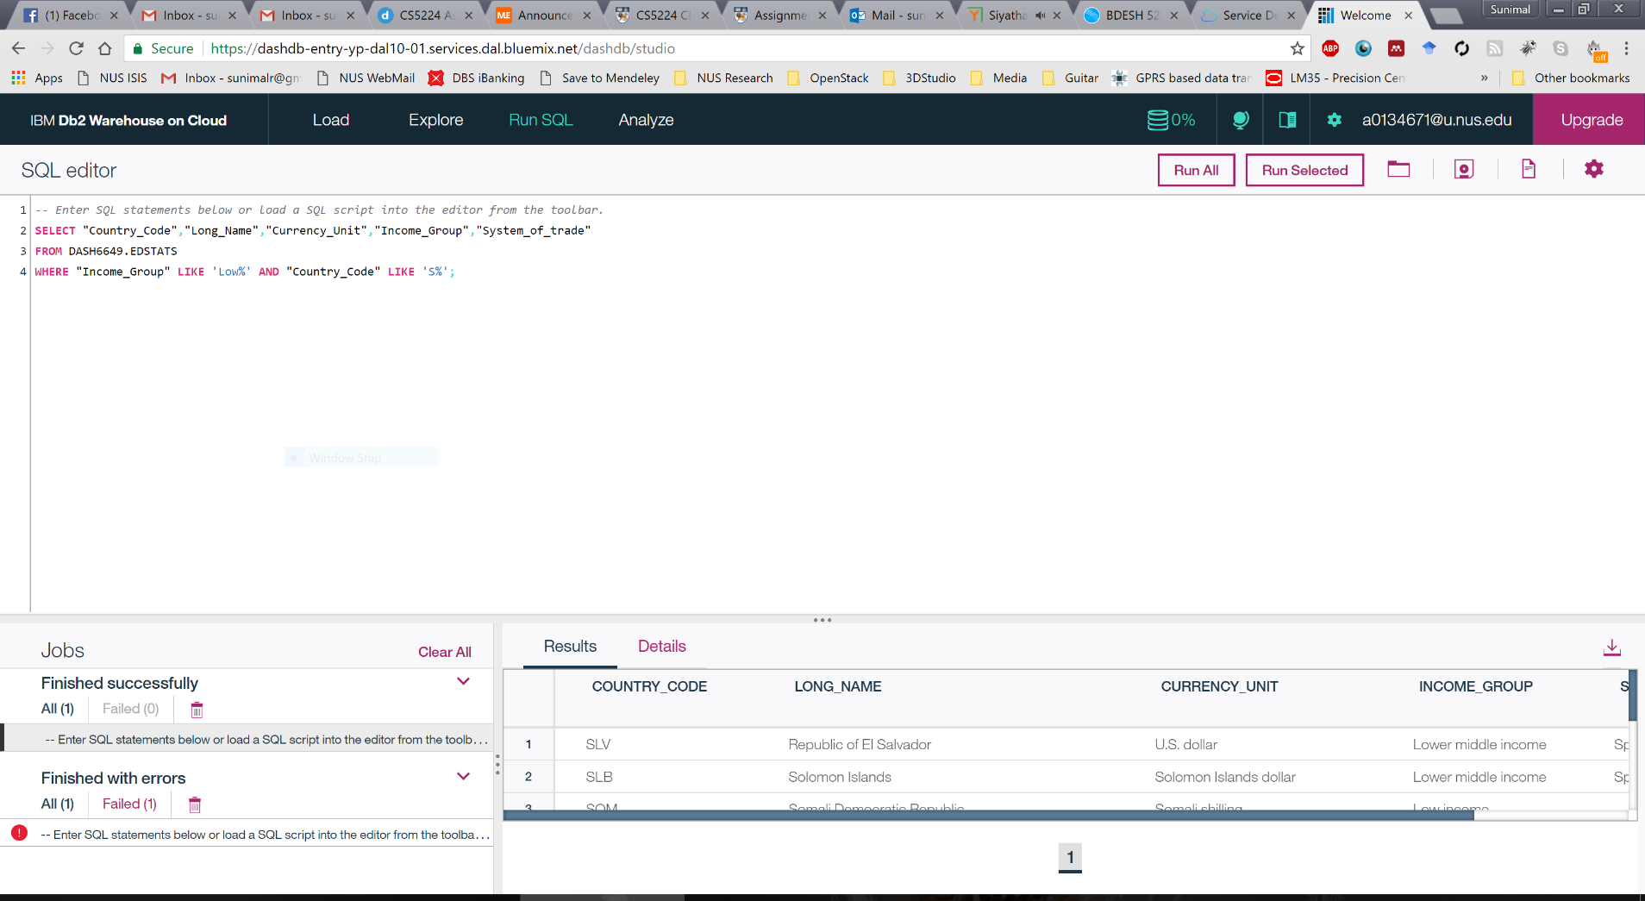
Step 6: Run SQL Query
Click “Run All” and get the result

Slide 78
Milestone 5: Run SQL Query
Did you successfully run the SQL?
Let’s wait until everyone is done!
In the meantime:
Explore more about Db2 at: https://www.youtube.com/watch?v=zm4-VZolYV0

Slide 79
Example 3-Part 2: Analytics with R scripting
R is a scripting language used for statistical computing including big data analysis, and data mining
IBM Cloud offers R language support with IBM Data Science Experience service also known as DSX service
Data loaded in an existing on-cloud database can be analyzed in a DSX project after properly linking the database to the DSX project
Objective: Perform simple analytics and visualization of data on cloud
Example: Load economic data of countries to a an IBM Db2 database, and, execute simple R scripts for filtering data and visualization with plots
Data: Economic data of countries from United Nations (stats.csv)
This is a continuation of Example 3-Part 1

Slide 80
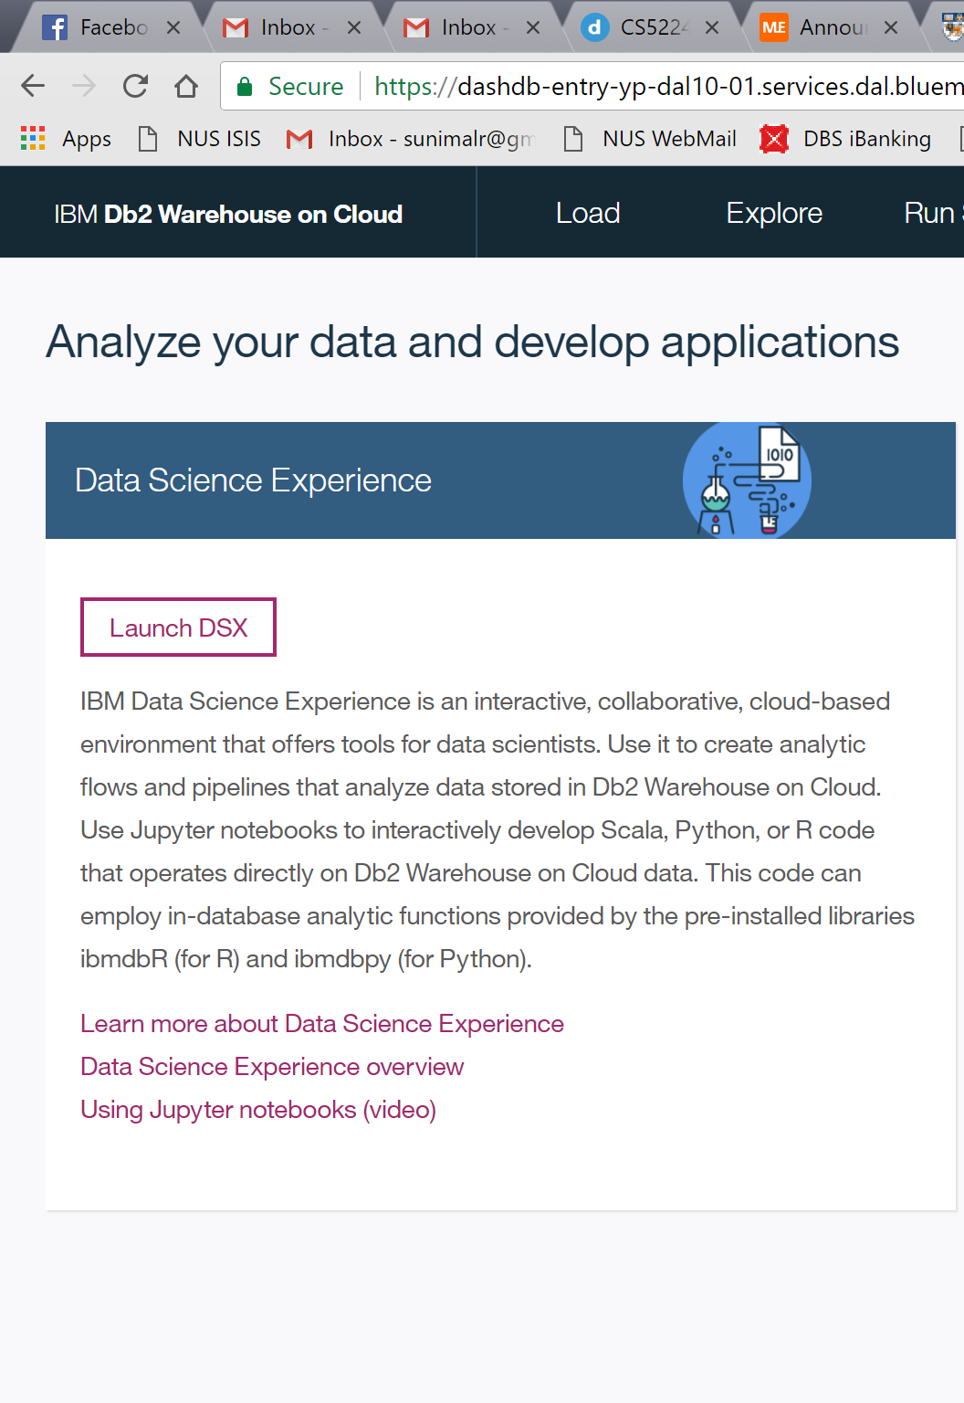
Step 7: Setup DSX
Click on “Analyze” in the Db2 console
Click “Launch DSX”

Slide 81
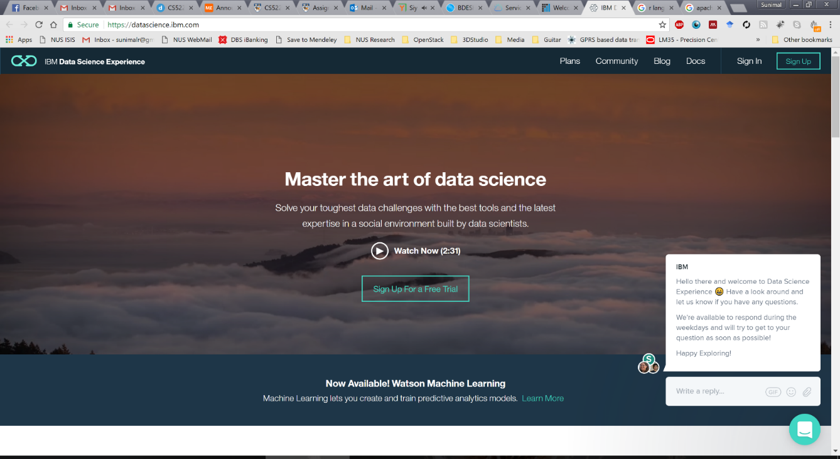
Step 7.1: Setup DSX (or Watson Studio)
Log in to DSX or (Watson Studio) (You may be asked to sign up the first time)
Some will see Watson Studio instead of DSX (If you get Watson Studio interface, please skip to Step 7.2 )

Slide 82
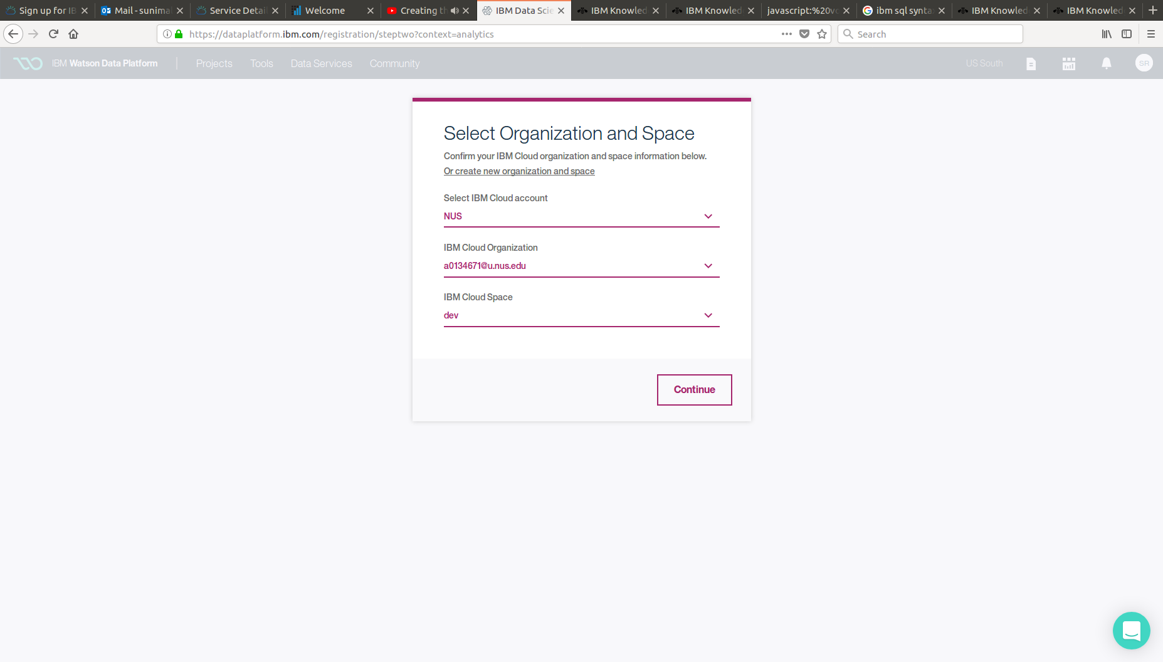
Step 7.1: Setup DSX
Select the relevant account details from drop down menus

Slide 83
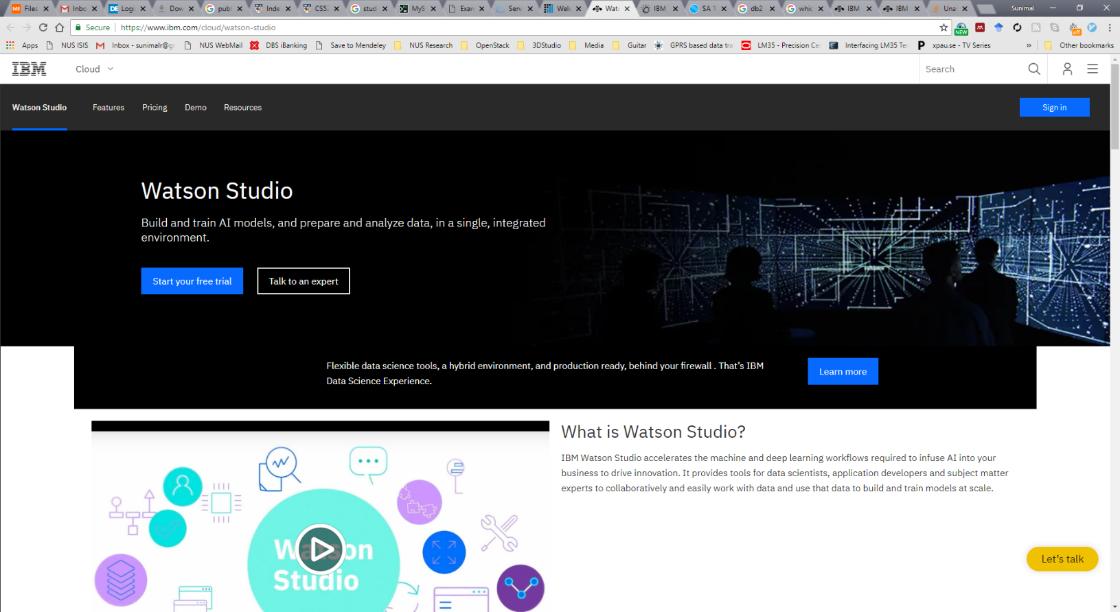
Step 7.2: Setup Watson Studio
You might be prompted to enter your account details including org name and space (like we did in part 1 and 2 of the demo)

Slide 84
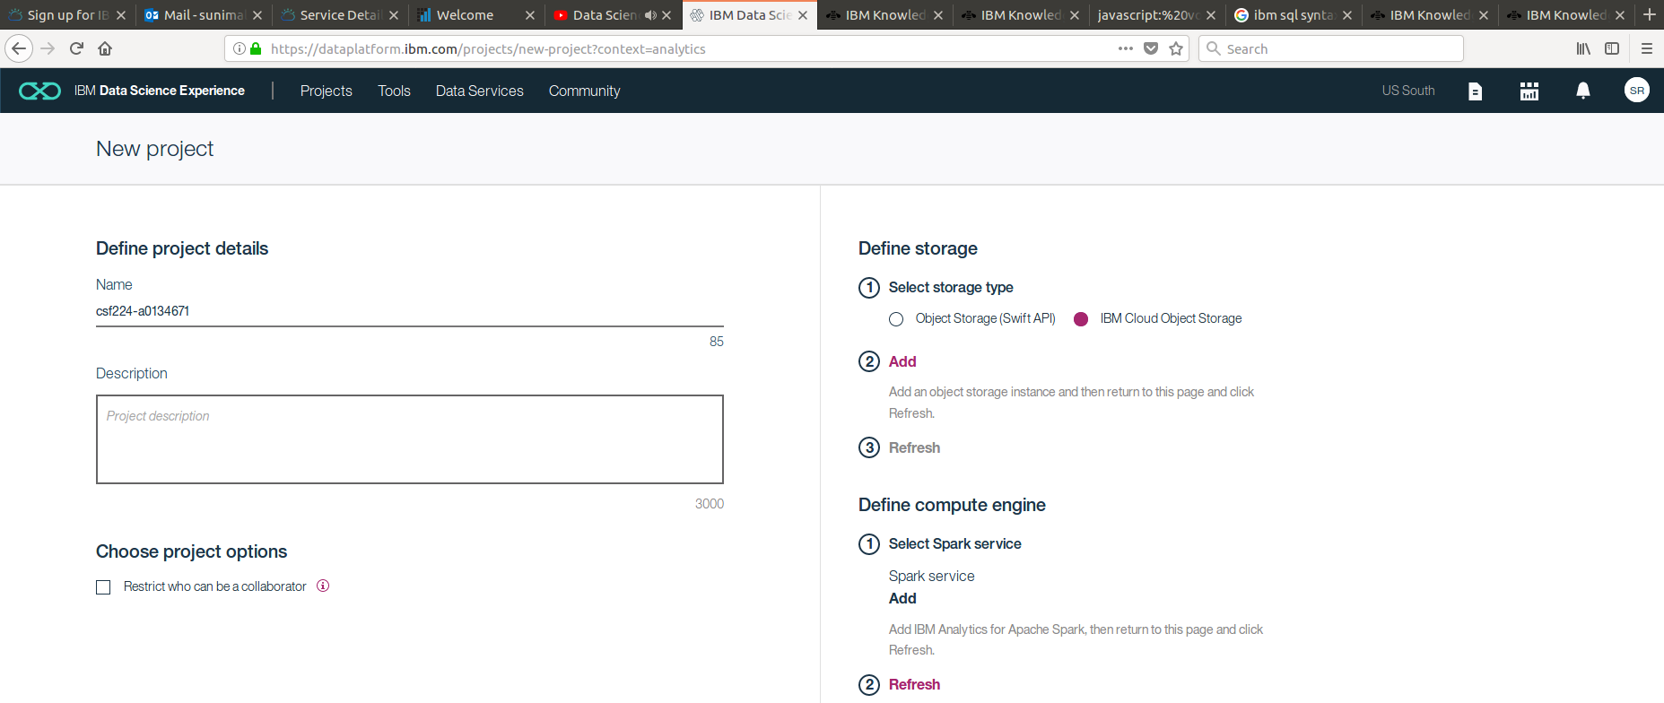
Step 8.1: Create new DSX project
(If you get Watson Studio interface, please skip to Step 8.2 )
Give a unique name for the DSX project
Select storage type – IBM Cloud Storage
Add a “Spark” service as the compute engine – Spark is a fast and general cluster computing system for Big Data. It provides high-level APIs in Scala, Java, Python, and R, and an optimized engine that supports general computation graphs for data analysis.

Slide 85
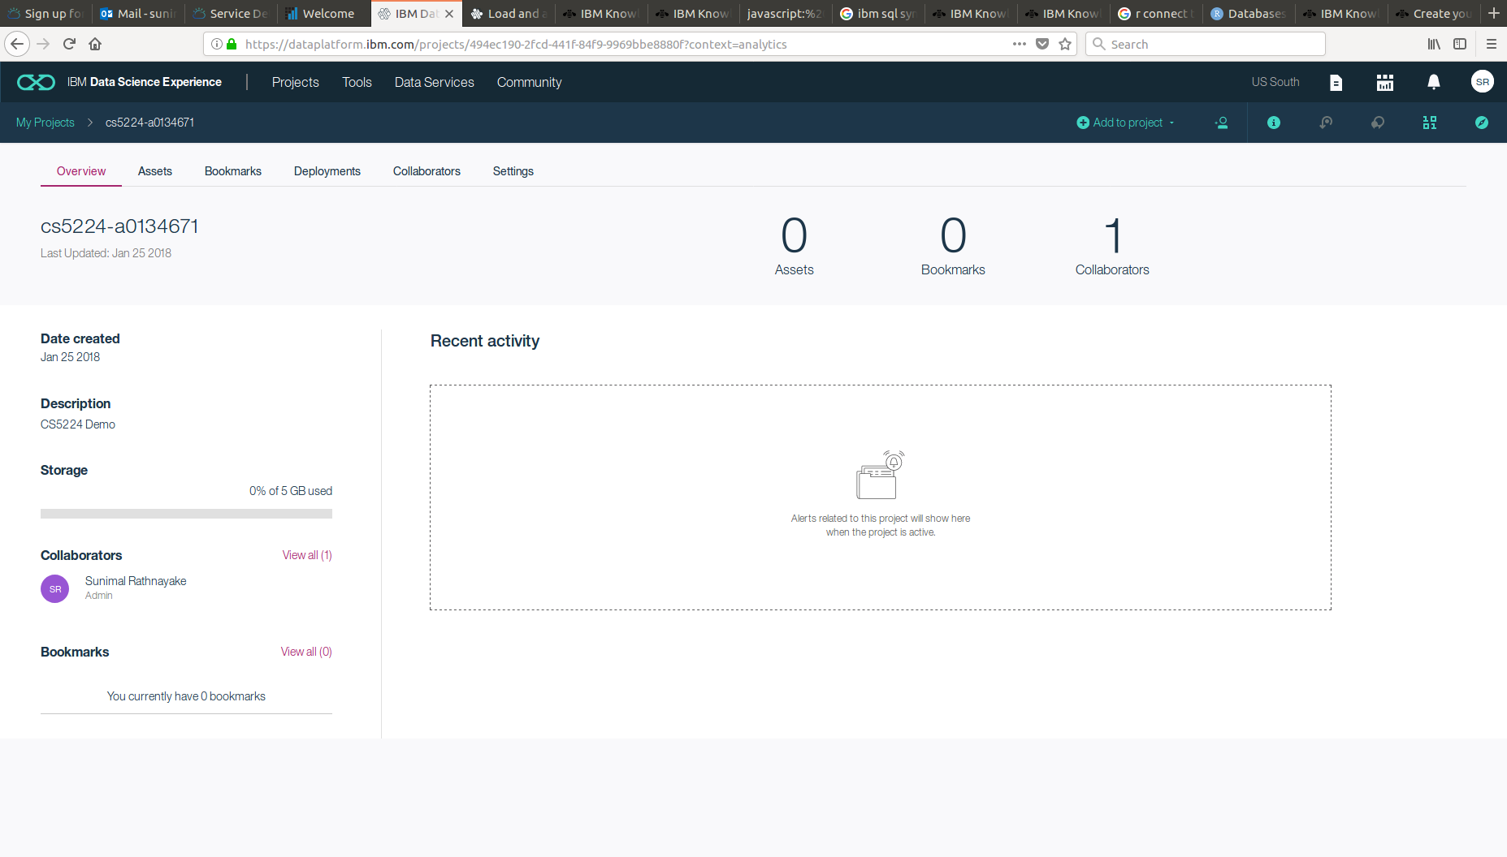
Step 8.1: Create new DSX project
Once the project is setup successfully, you should arrive at this portal

Slide 86
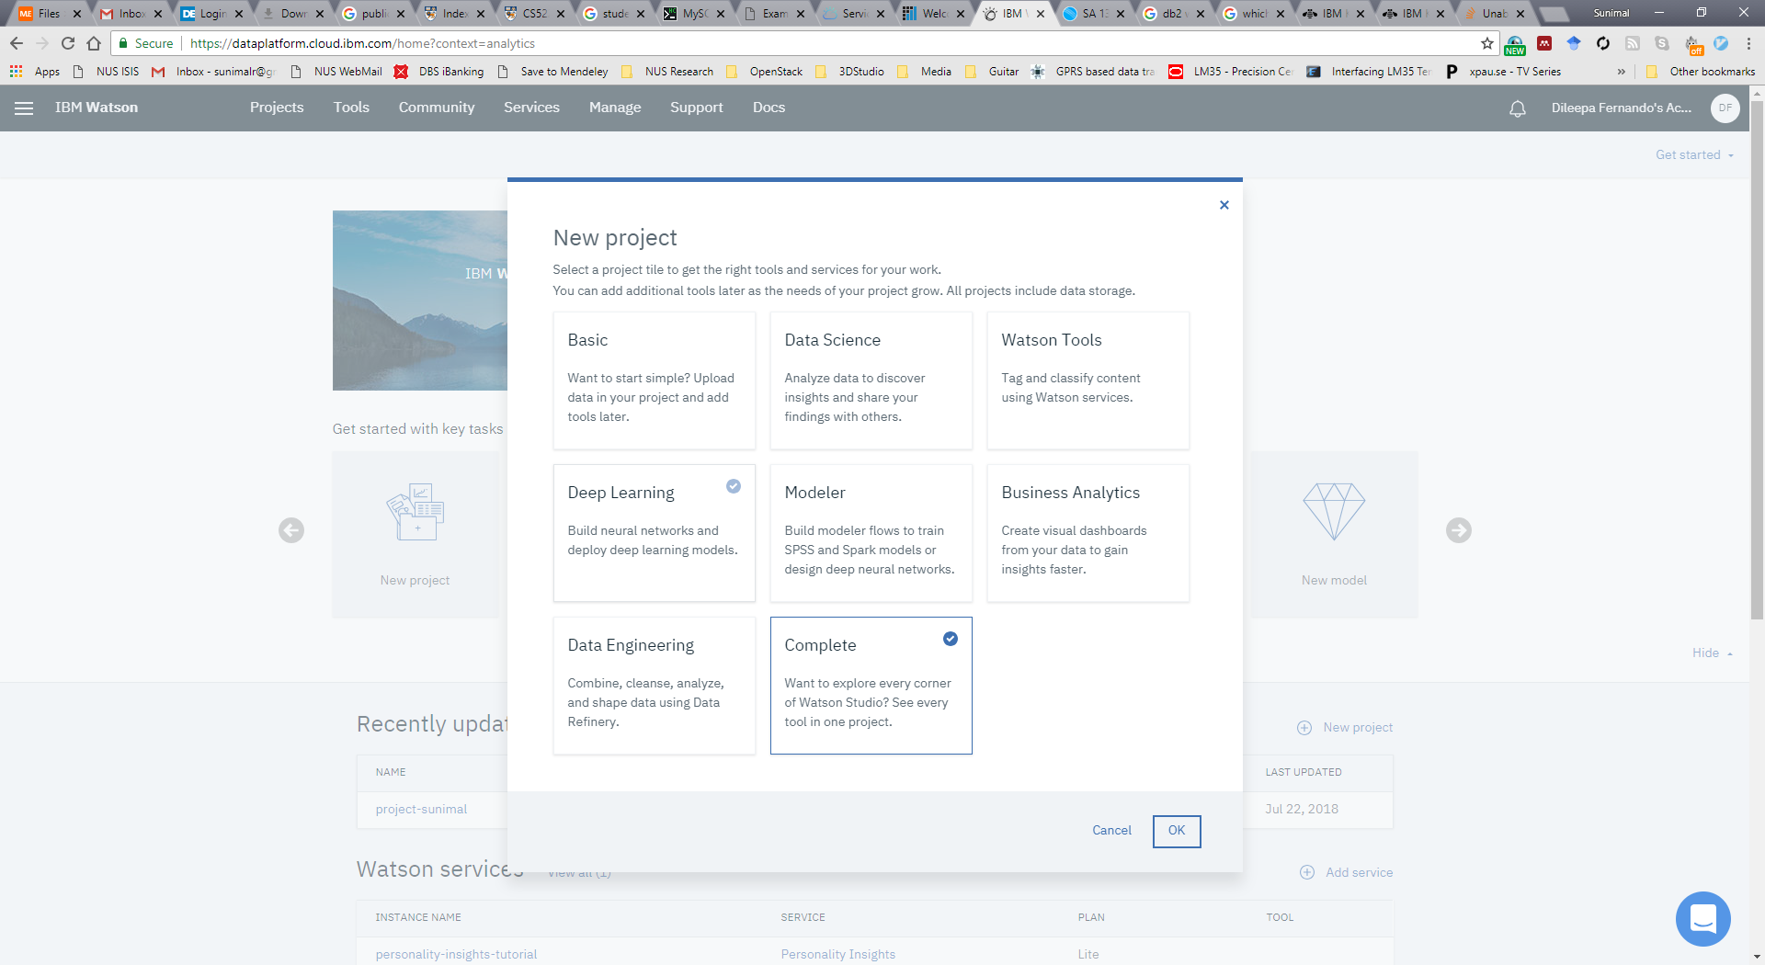
Step 8.2: Create new Watson Project
Click on “new project” and select complete

Slide 87
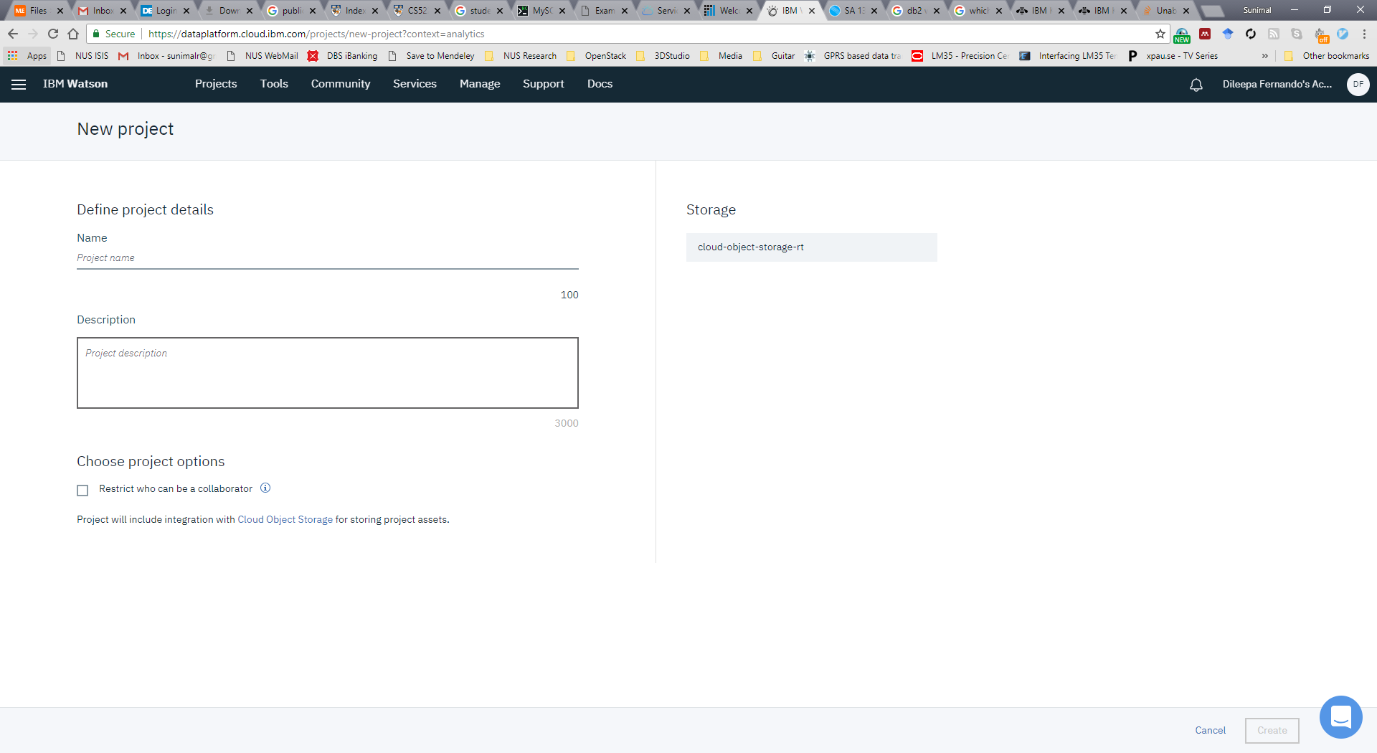
Step 8.2: Create new Watson Project
Give a unique name for the project
In the first time, you may be prompted to create a storage service. In this case, please create and add an “Cloud Object Storage Service”

Slide 88
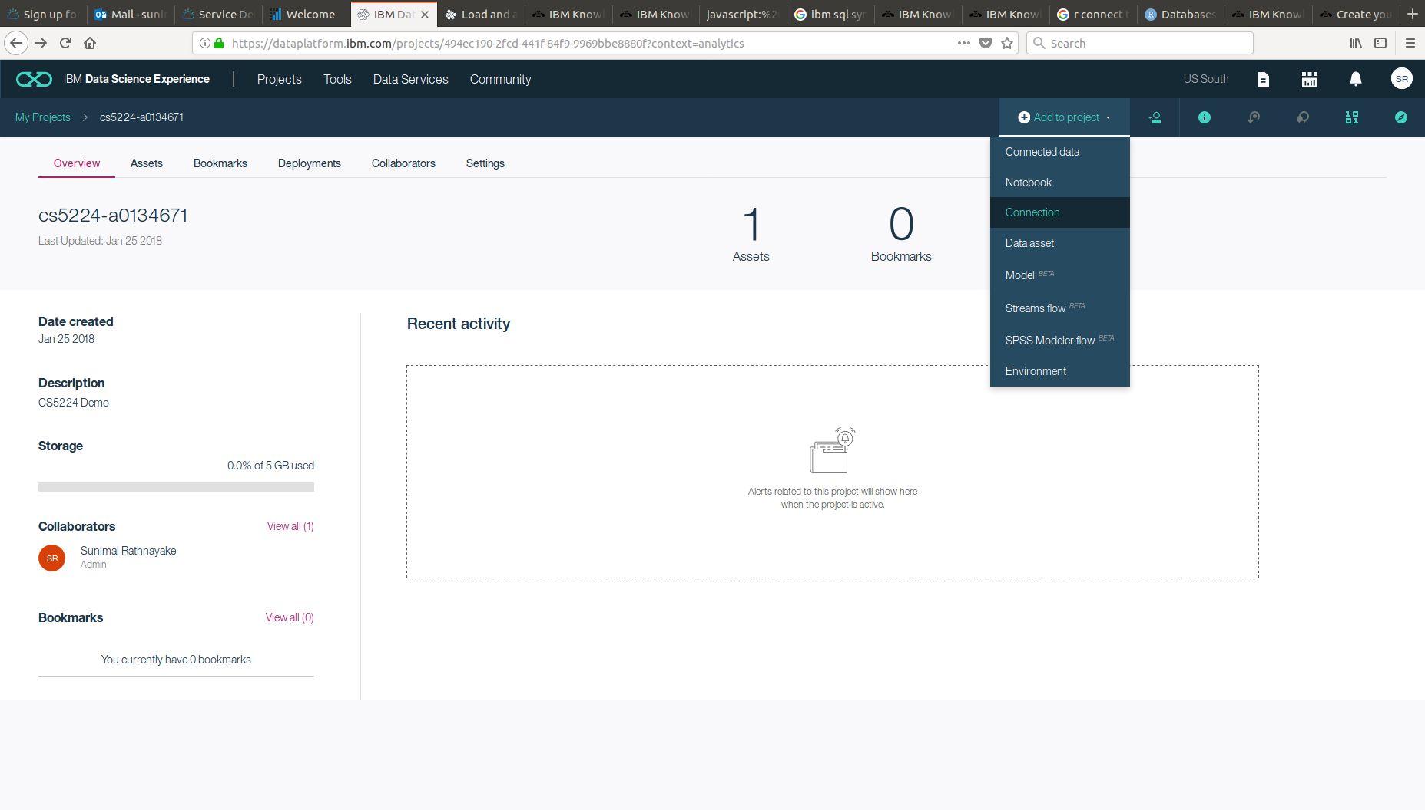
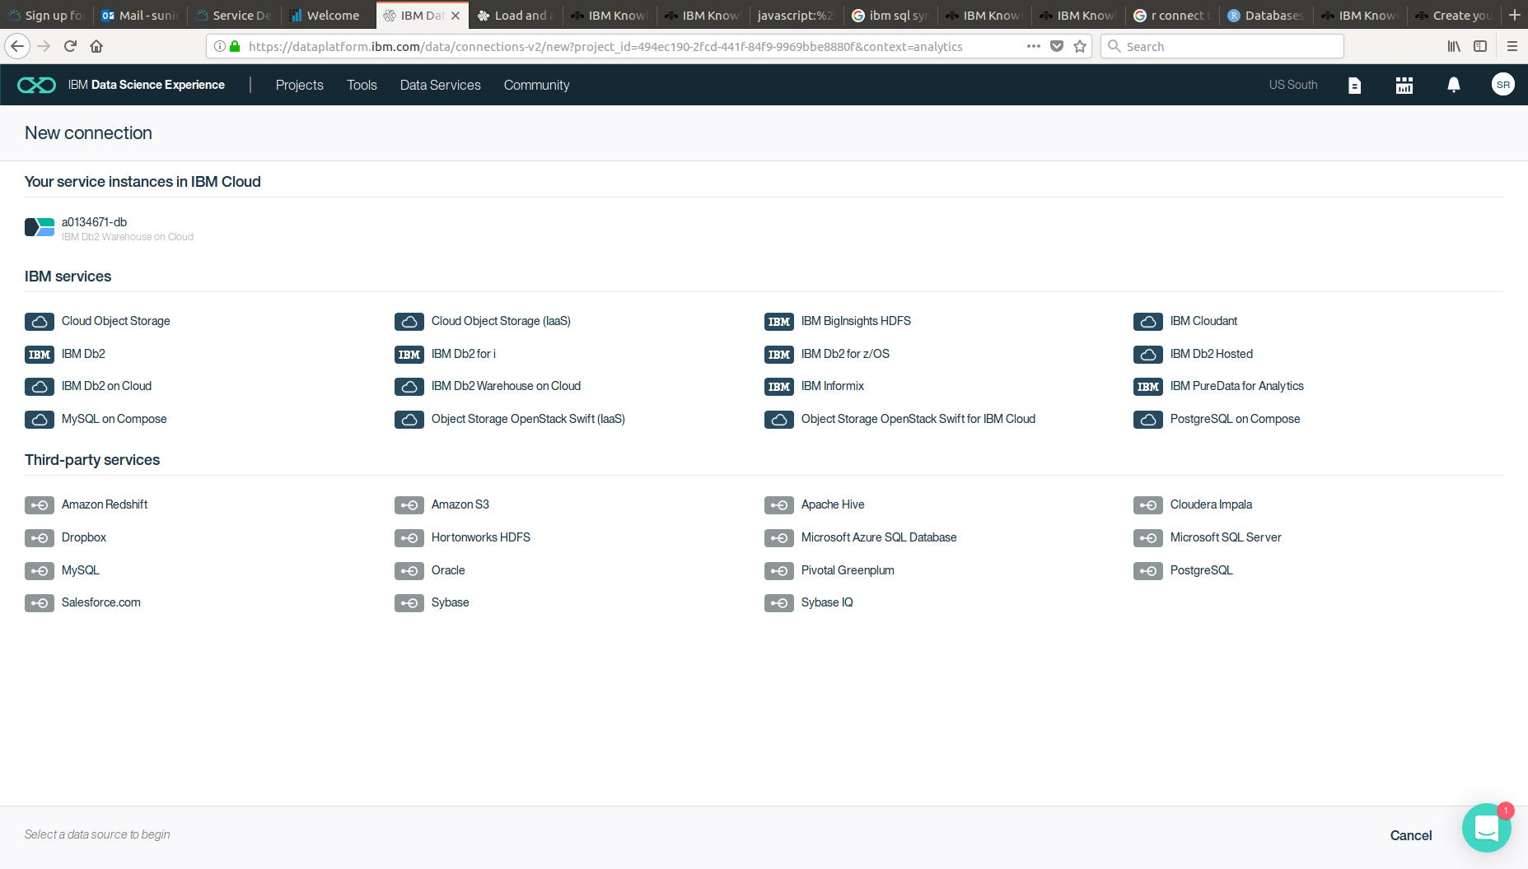
Step 9: Connect to Db2 database
We need to connect DSX project to our previously created Db2 database
Select IBM Db2 Warehouse on Cloud

Slide 89
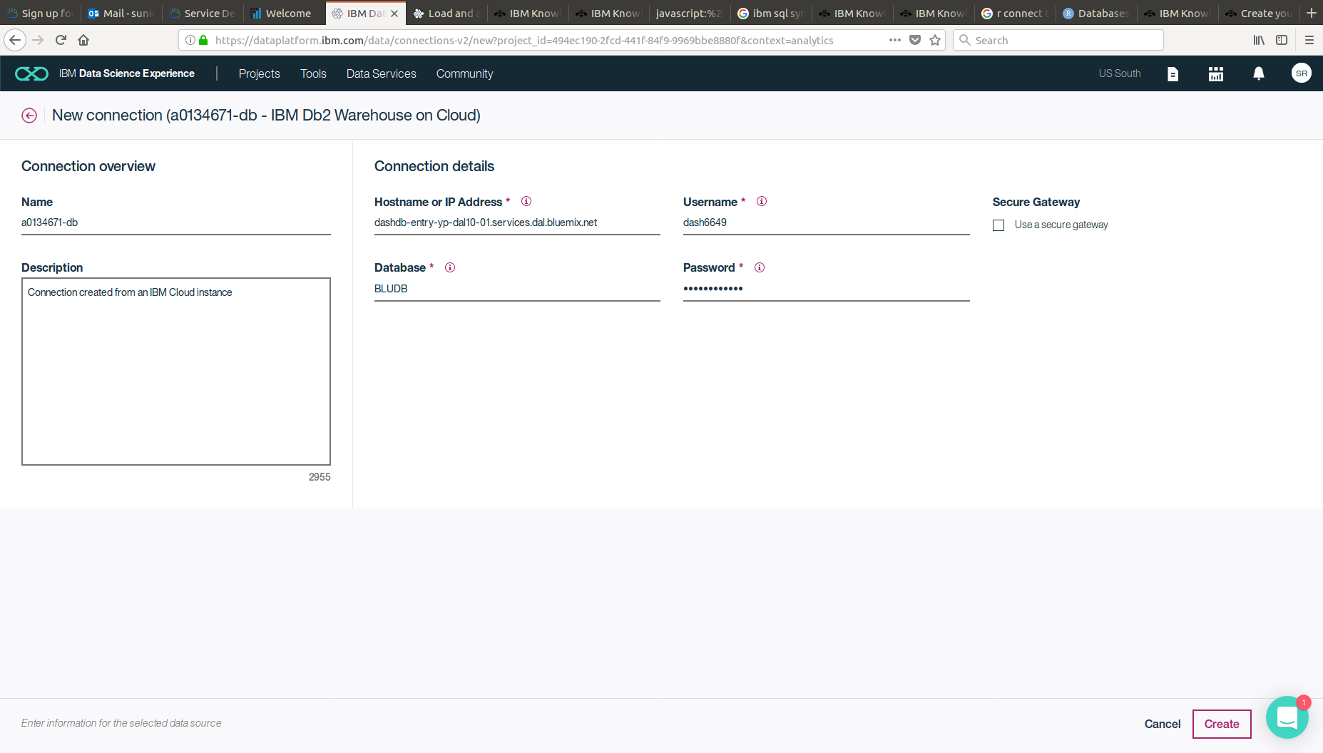
Step 9: Connect to Db2 database
Fill in the data. You can get/generate Connection Details including database password from the Credentials section of the DB2 Warehouse console. (see next slide)

Slide 90
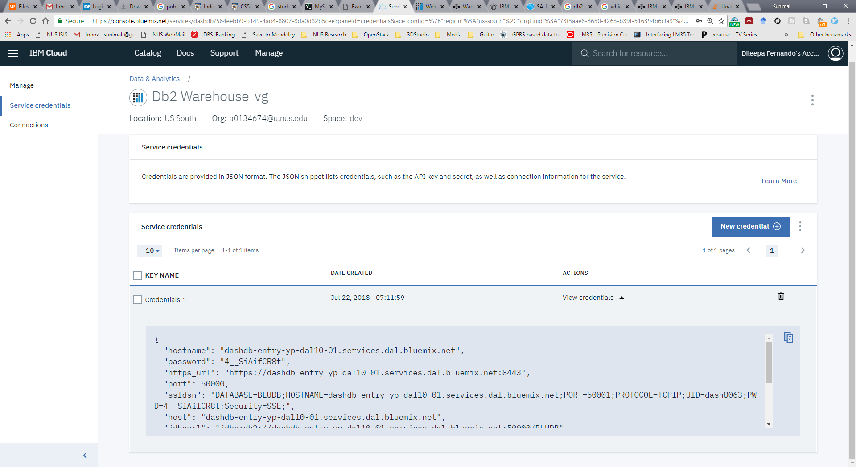
Step 9: Connect to Db2 database (Get Credentials)
Open IBM Bluemix Console in a new browser tab and navigate to the DB2 Warehouse service we created.
In the DB2 Warehouse console, you will see “Service Credentials” section
If this is empty, click “New Credential” to add a new one

Slide 91
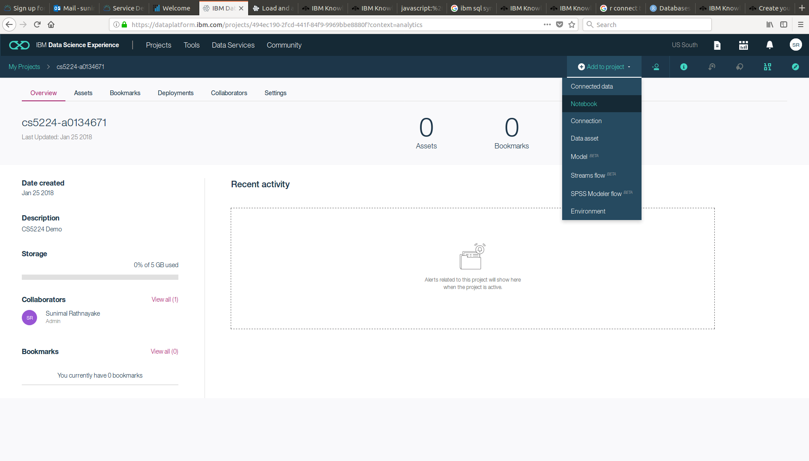
Step 10: Create a new R Notebook
Add a new Notebook
Once you select “Notebook”, you will be asked to fill in details including the scripting language.
Select “R” as the language from the dropdown list.
Notebook is an online interpreter that allows scripting in different languages like R, Python etc.

Slide 92
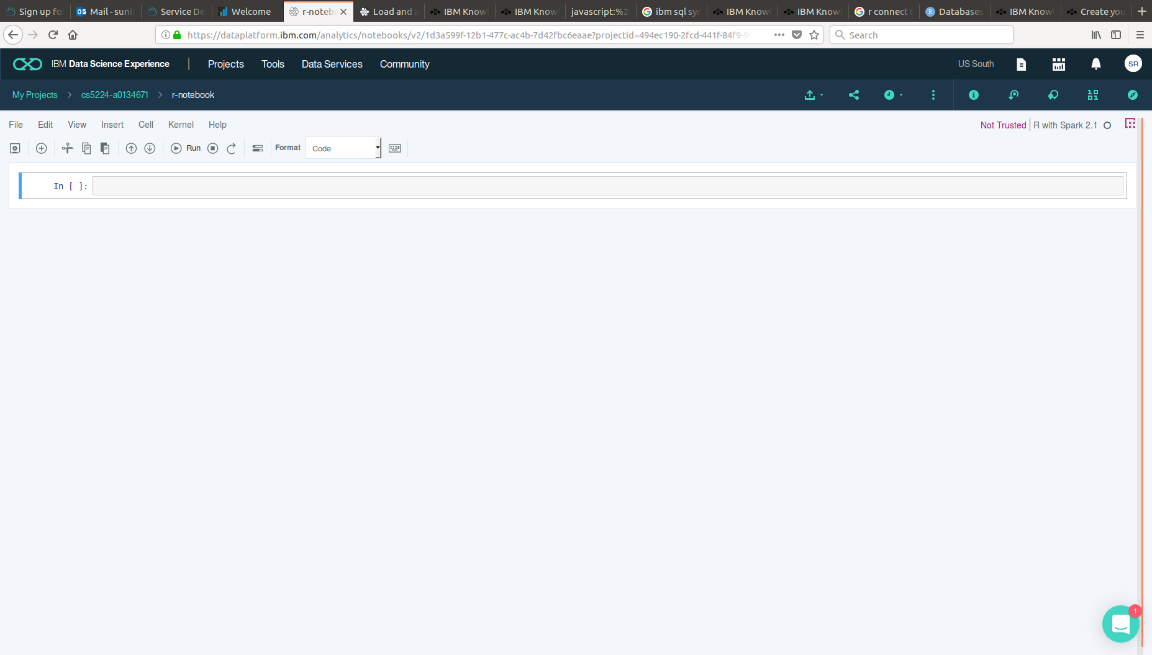
Step 10: Create a new R Notebook
Created R notebook should look like this
R scripts could be written here and interpreted online in real time

Slide 93
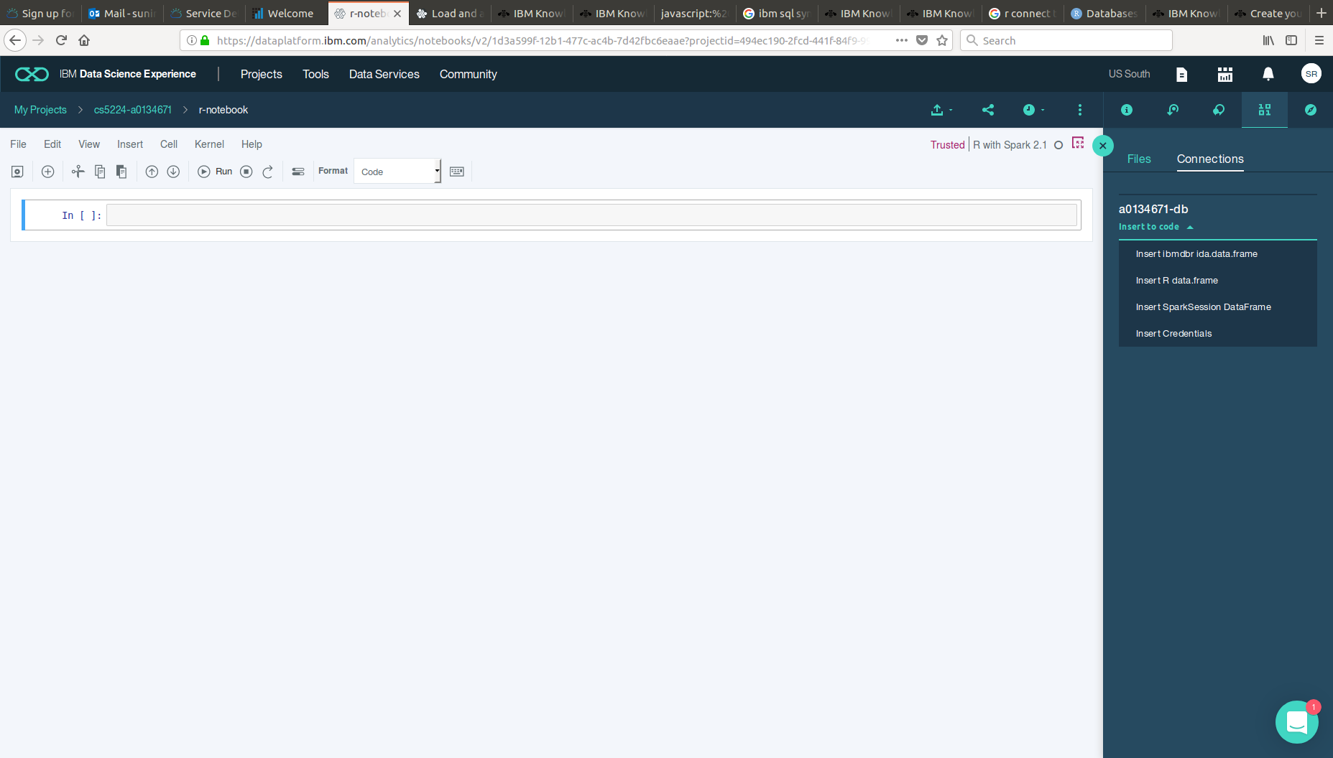
Step 11: Insert R data frame
Insert a R data frame from the data connection.

Slide 94
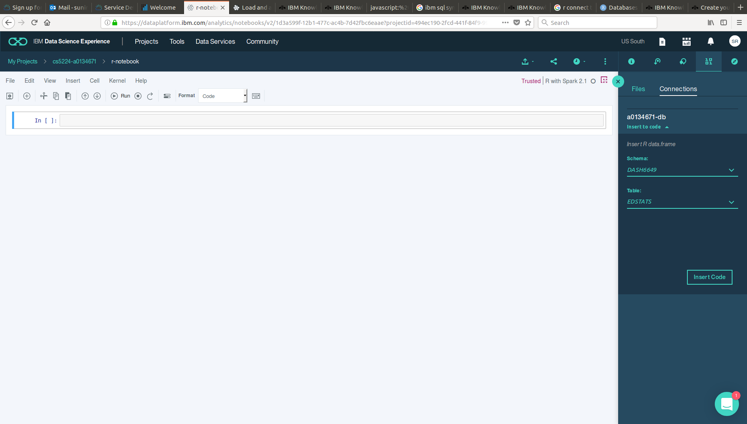
Step 11: Insert R data frame
Insert a R data frame from the data connection.
Select the data scheme name and table name (STATS) from the drop down lists and click “Insert Code”

Slide 95
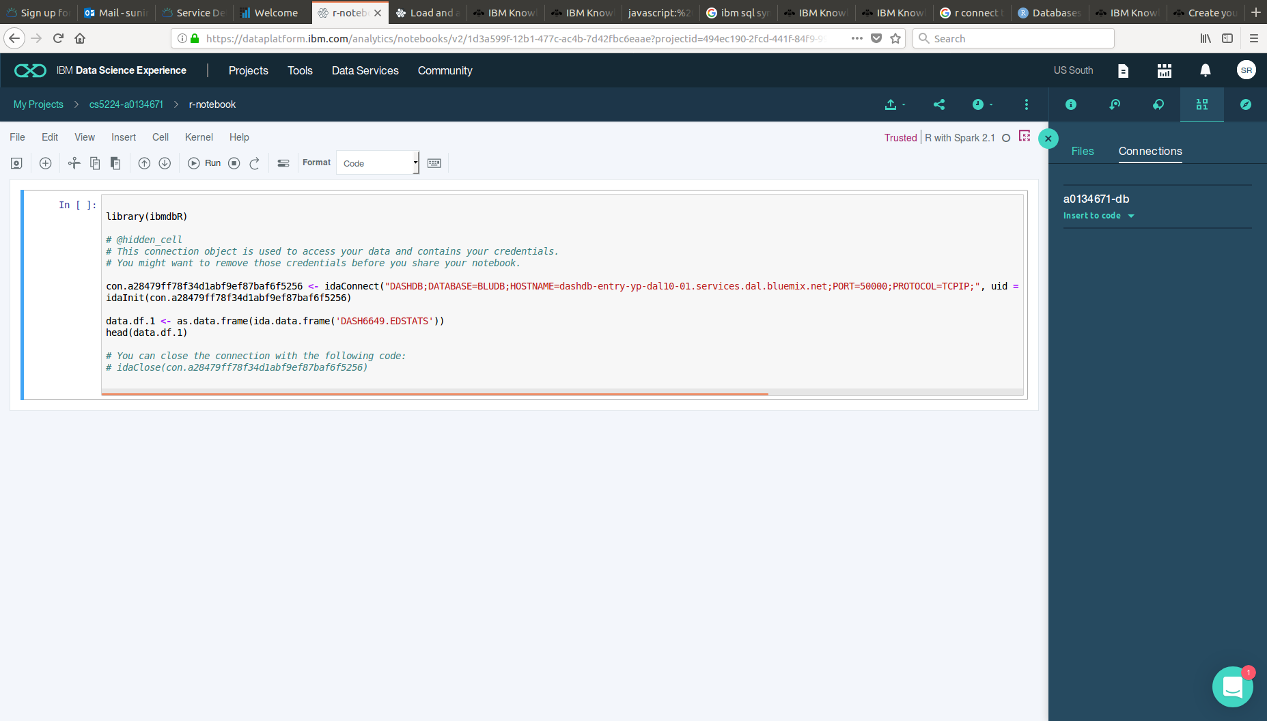
Step 11: Insert R data frame
Insert a R data frame from the data connection.
Inserted data frame looks like this. Data is a pointer to the database . We can use the data frame to process database contents as we like.

Slide 96
Step 11: Insert R data frame
Insert a R data frame from the data connection.
Click “Run” to execute the script
Inserted data frame looks like this. Data is a pointer to the database . We can use the data frame to process database contents as we like.

Slide 97
Step 12: Write R script to Plot Data
# Load the plotting package
library(ggplot2)
# Plot the count of countries across different income groups
#Classify the levels and label them: Create a factor
data_frame1<- as.data.frame(ida.data.frame('DASH6649.EDSTATS'))[ ,c('Currency Unit', 'Income Group', 'Region', 'Short Name')]
data_frame1$"Income Group" <- factor(data_frame1$"Income Group",levels=c("Low income","Lower middle income","Upper middle income","High income: nonOECD","High income: OECD"), labels=c("LI","LMI","UMI","HIN","HIO"))
#Count the income groups
counts <- table(data_frame1$"Income Group")
#Plot counts versus the labelled income groups
barplot(counts, main="Income Distribution",xlab="Income Group")

Slide 98
Step 12: Write R script to Plot Data
library(ggplot2)
data_frame1<- as.data.frame(ida.data.frame('DASH6649.EDSTATS'))[ ,c('Currency Unit', 'Income Group', 'Region', 'Short Name')]
data_frame1$"Income Group" <- factor(data_frame1$"Income Group",levels=c("Low income","Lower middle income","Upper middle income","High income: nonOECD","High income: OECD"), labels=c("LI","LMI","UMI","HIN","HIO"))
counts <- table(data_frame1$"Income Group")
barplot(counts, main="Income Distribution",xlab="Income Group")

Slide 99
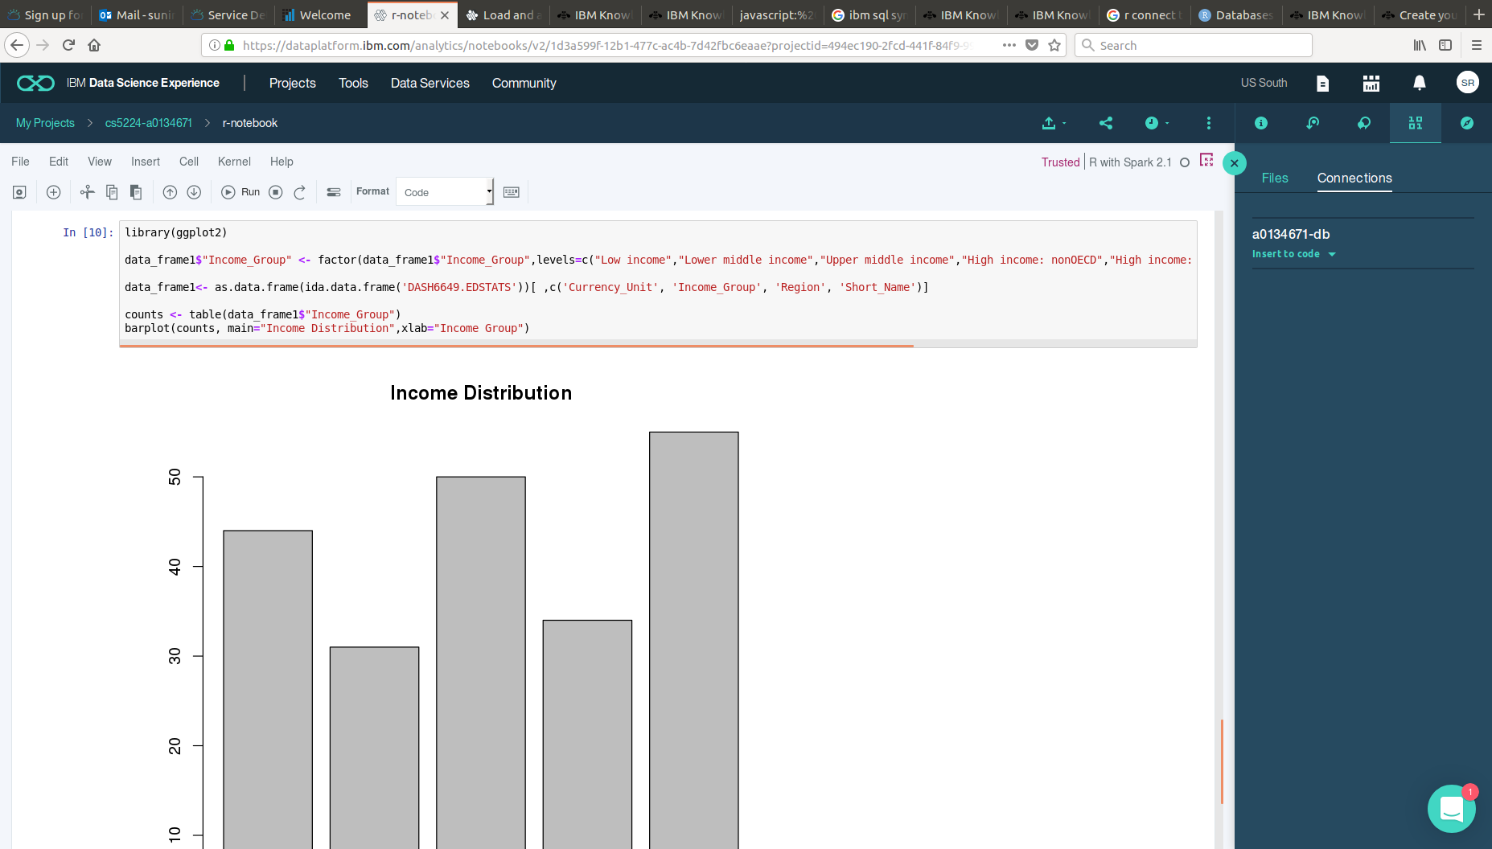
Step 13: Output the Plot

Slide 100
Milestone 6: Visualize data
Did you successfully visualize the data retrieved from the database?
Congratulations! This is the last step of the hands on activity. You may refer to the references section at the end of the presentation slides to learn more or search on the web.
Next step : Lab Assessment

Slide 101
Lab Assessment
Download from Course Website or http://www.comp.nus.edu.sg/~sunimalr/files/P02-assessment.zip
Deadline: 24 July 2018, 9:00AM
Submit to the relevant folder under IVLE workbin in PDF format. (https://ivle.nus.edu.sg/ )
Contact me (sunimalr@comp.nus.edu.sg) if you have any issues in submitting.

Slide 102
Summary
hands-on with BlueMix
simple web server application using node.js and Db2
integrating IBM Watson personality insights service with a node.js web application
simple SQL query using Db2 Warehouse SaaS
simple R script to plot results of data on Db2 and DSX

Slide 103
References
NodeJS-DashDB example
Demo: Getting Started with Node.js on Bluemix 2016- https://www.youtube.com/watch?v=sHhNoV-sS_I&list=PLJxa6IsF8C5qFbRinR2ZaEZ3AiIFtdLqx (13 mins)
IBM Bluemix The Cloud Platform for Creating and Delivering Applications, IBM Redbooks, 2015.
Bluemix users: https://www.ibm.com/cloud-computing/bluemix/case-studies
Watson SDK help: https://github.com/watson-developer-cloud/node-sdk
Watson startup guide: https://console.bluemix.net/docs/services/watson/developing-nodejs.html#developing-a-watson-application-in-node-js
IBM dashDB:
http://www-01.ibm.com/support/knowledgecenter/SS6NHC/com.ibm.swg.im.dashdb.kc.doc/welcome.html
SQL Query: http://www.w3schools.com/sql/
R Language:
http://cran.r-project.org/doc/manuals/r-release/R-intro.html
Plotting: http://docs.ggplot2.org/current
IBM DSX Getting Started Guide: https://datascience.ibm.com/docs/content/getting-started/get-started.html
IBM DSX Tutorials: https://github.com/IBMDataScience/dsx-tutorials

